Slide 1



Delving in to Blockchain
Sriram
Technology of Trust

Slide 2

Course Objectives
After completing this module, you should be able to:
Understand different types of networks
Cryptocurrency and its growth
Explain Blockchain and its uses
Grasp the components of a Blockchain ecosystem
Induce the structure and mechanisms of a Blockchain
Deduce various cryptography and consensus algorithm
Fathom different types of Blockchain
Infer various types of Blockchain platforms
Key Concepts in Blockchain
Bitcoin and its usage

Slide 3


Types of Networks

Slide 4
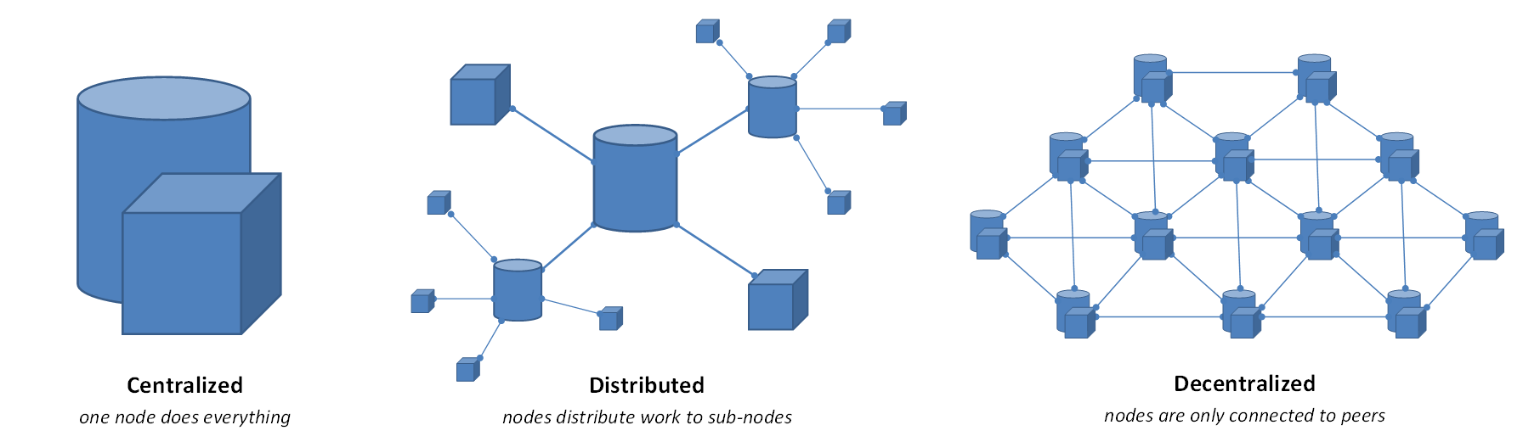


Types of Networks
Centralized
One (1) or more than one (>1) nodes are connected to a single server.
Terminals are controlled by a single server
Distributed
More than one (>1) server are connected to a network and controlled by single network
Decentralized
More than one (>1) server connected to network
Each server can do its task independently

Slide 5

Centralized & Decentralized System
Centralized System:
System governed by a person or organization
This is managed by a trusted group who decide the protocol
Following are some examples of the challenges in the Centralized Systems
Fund transfer between 2 parties involves bank and 3rd parties like Visa
Delay by clearing house to settle the trades
Buy/Sell of real estates
Executing contracts
Conducting election
Anonymity
History of hacking even the highly secured systems
Decentralized System:
System governed by a network of nodes
All nodes works as per the pre-designed protocol

Slide 6
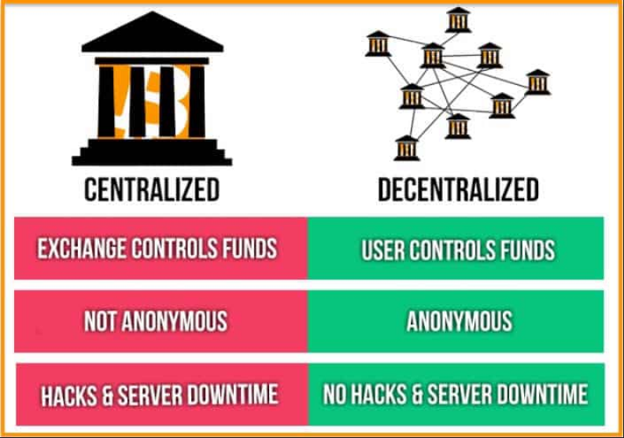
Centralized Vs Decentralized System

Slide 7
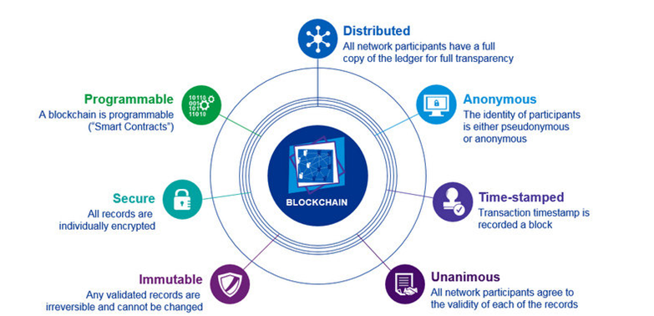
Distributed Ledger

Slide 8
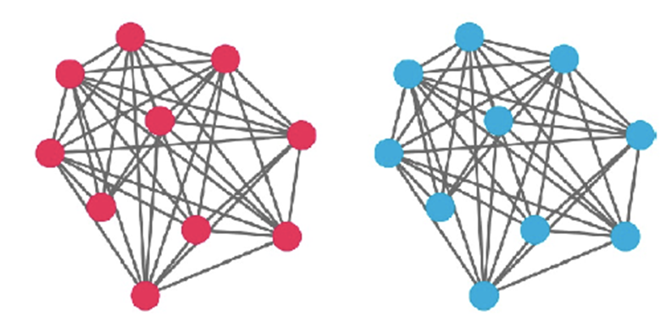
Distributed Ledger
Shared Ledger spread across multiple sites, countries, or institutions
No central administrator or centralized data storage
Peer to peer network
Umbrella term used to describe technologies which distribute records or information
Blockchain was the first fully functional Distributed Ledger Technology
IOTA and Tangle, Hashgraph, Raiblocks (now Nano)
Distributed Ledgers can be either public or private and vary in their structure and its size.
Users (.) are anonymous. Each user has a copy of the ledger and participates in confirming transactions independently.
Users (.) are not anonymous. Permission is required to users to have a copy of the ledger and participate in confirming transactions

Slide 9
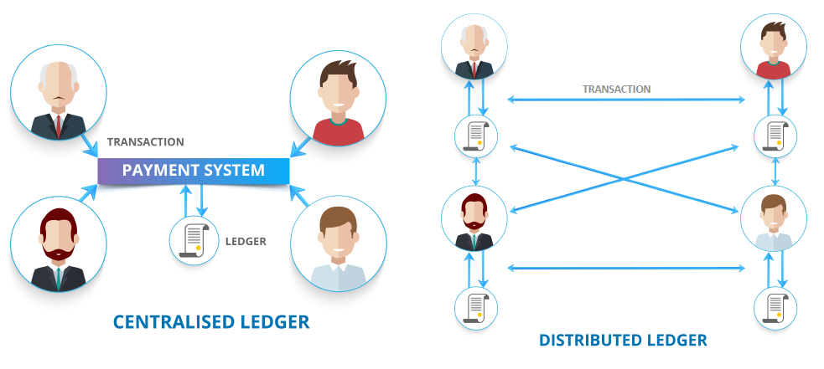
Centralized Vs Distributed

Slide 10
Cryptocurrency

Slide 11
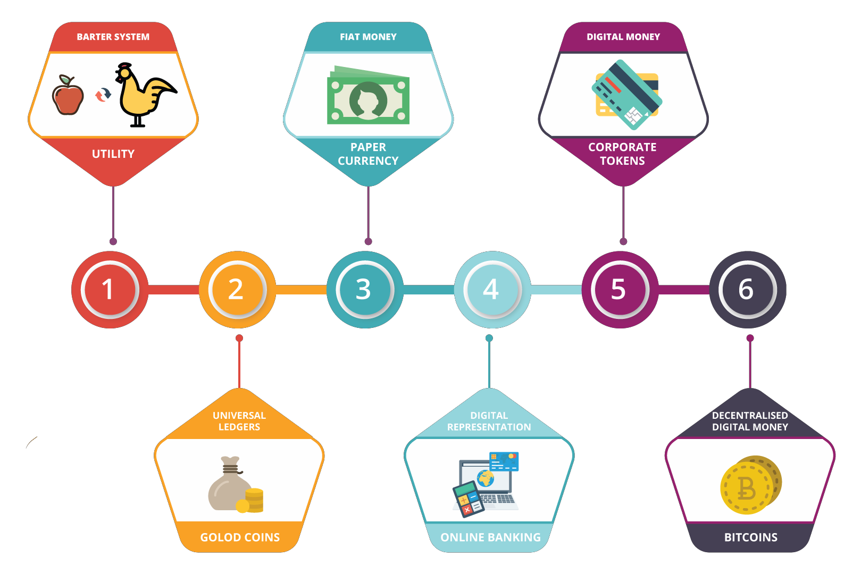
How has Money Transformed?
GOLD COINS

Slide 12
What is Cryptocurrency?
A Cryptocurrency is a digital or virtual currency designed to work as a medium of exchange. It uses cryptography to secure and verify transactions as well as to control the creation of new units of a particular cryptocurrency. Essentially, cryptocurrencies are limited entries in a database that no one can change unless specific conditions are fulfilled.
Missing Money: What would you do if someday all your money is stolen? Or the government rapidly starts printing currency notes inflating the economy and devaluating your currency? Ordinary people have no control over the monetary economy nor can take decisions such as monetary policies. All of these directly affect our money, whether it is in Rupee, Dollar, Yen or Euro. Banks and governments control institutions which have a monopoly over their circulation and often charge huge transaction fees.
Cryptocurrencies were invented to overcome these issues: Bitcoin was the first cryptocurrency that was created. A cryptocurrency is a parallel economy to the existing currencies. There are fixed rules as to how much amount of the cryptocurrency is in circulation and how new money should be created. Algorithms help to maintain the security of these systems and it is close to impossible to steal currency from these systems.
GOLD COINS

Slide 13
How Cryptocurrency works?
A cryptocurrency like Bitcoin consists of a network of peers. Every peer has a record of the complete history of all transactions and thus of the balance of every account.
A transaction is a file that says, “Bob gives X Bitcoin to Alice “and is signed by Bob ‘s private key. It’s basic public key cryptography, nothing special at all. After signed, a transaction is broadcasted in the network, sent from one peer to every other peer. This is basic p2p-technology. Nothing special at all, again.
The transaction is known almost immediately by the whole network. But only after a specific amount of time it gets confirmed.
Confirmation is a critical concept in cryptocurrencies. You could say that cryptocurrencies are all about confirmation.

Slide 14
How Cryptocurrency works?
As long as a transaction is unconfirmed, it is pending and can be forged. When a transaction is confirmed, it is set in stone. It is no longer forgeable, it can ‘t be reversed, it is part of an immutable record of historical transactions: of the so-called Blockchain.
Only miners can confirm transactions. This is their job in a cryptocurrency-network. They take transactions, stamp them as legit and spread them in the network. After a transaction is confirmed by a miner, every node has to add it to its database. It has become part of the Blockchain.

Slide 15
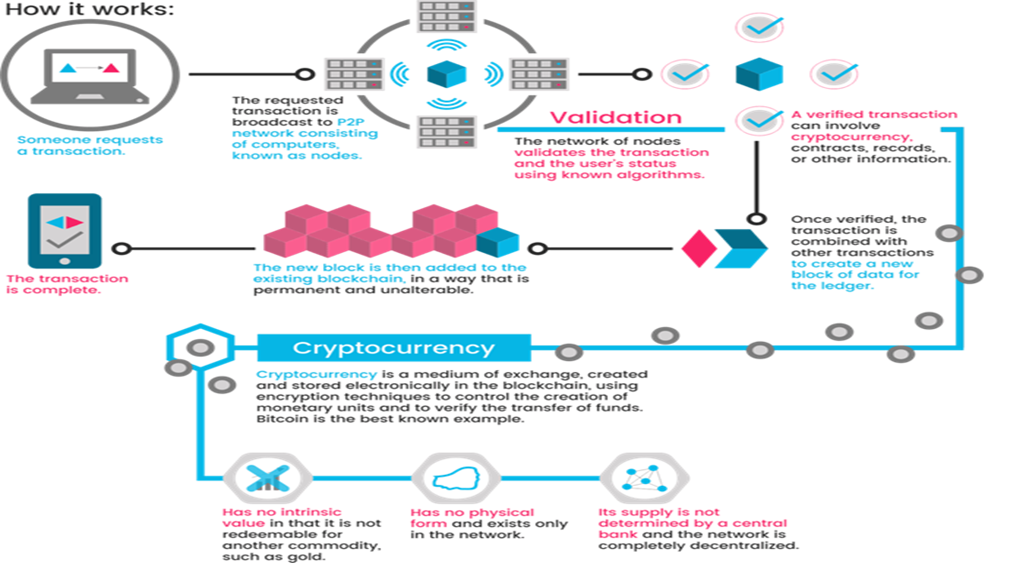
How Cryptocurrency works?

Slide 16
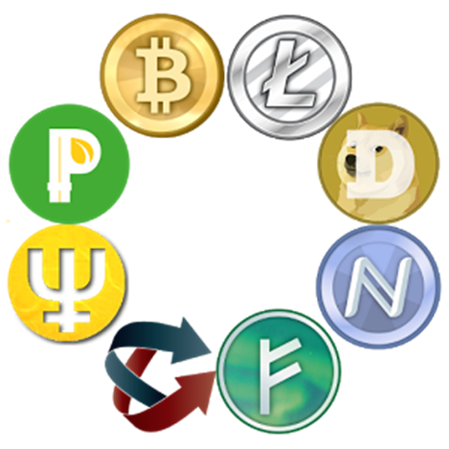
Digital Currency
Decentralized currency
Open Source
Peer to peer
Easy to use
Unregulated
Anonymous yet transparent
Fast but irreversible transfers

Slide 17

What is a Bitcoin?
Bitcoin is a type of cryptocurrency which is nothing but “digital money”.
And the underlying technology that enables moving of digital coins or assets among individuals is Blockchain

Slide 18




Defining Blockchain?
Blockchain is simply a data structure where each block is linked to another block in a time-stamped chronological order.
It is a distributed digital ledger of an immutable public record of digital transactions.
Every new record is validated across the distributed network before it is stored in a block .
All information once stored on the ledger is verifiable and auditable but not editable.
Each block is identified by its cryptographic signature.
The first block of the Blockchain is know as the Genesis block.
New Blocks
To access data of the first ever created block, you have to traverse from the last created block to the first block
[
First Block
Growing Blockchain

Slide 19
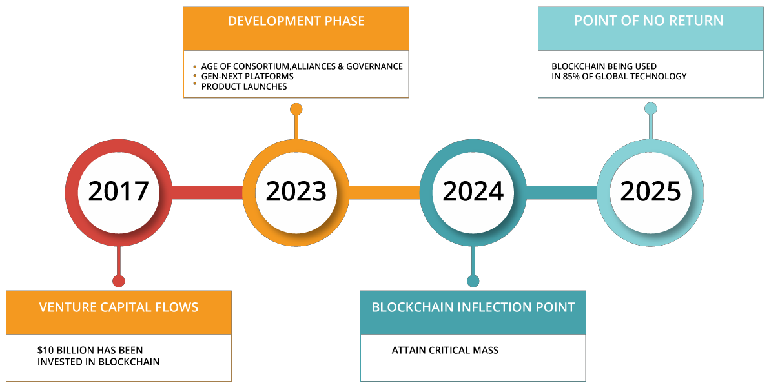
Blockchain Tectonic Shift

Slide 20
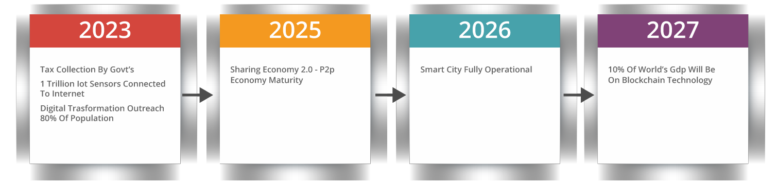
Blockchain Tipping Point & Societal Impact
Tax Collection by Govt’s
1 Trillion IoT Sensors Connected to Internet
Digital Transformation
Outreach 80% of Population
Sharing Economy 2.0 – P2P Economy Maturity
Smart City Fully Operational
10% of World’s GDP will be
on Bitcoin Technology

Slide 21
How Current System Works?
Before going Deeper into the details of Blockchain, let’s see How our current system works

Slide 22
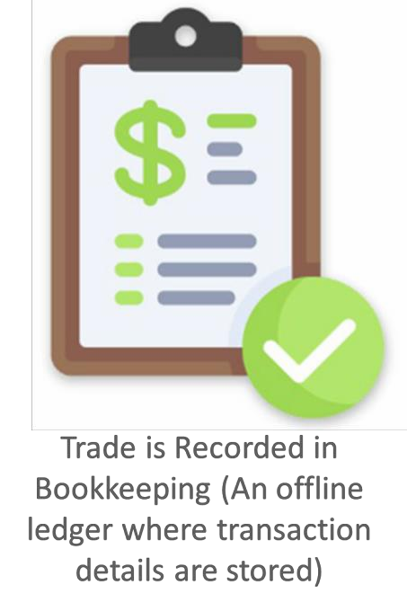
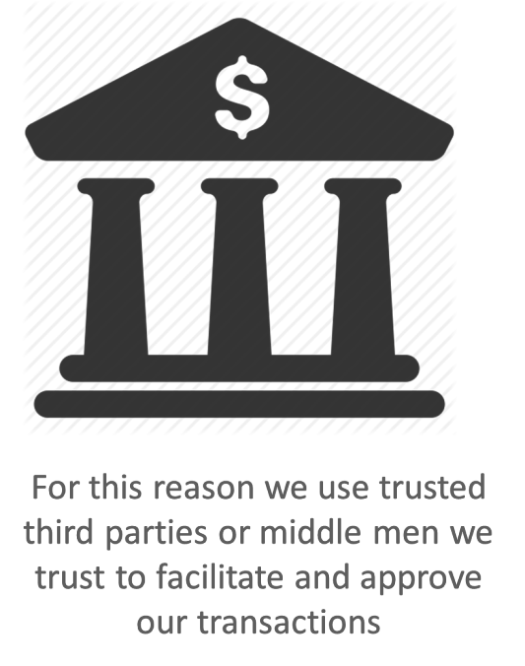
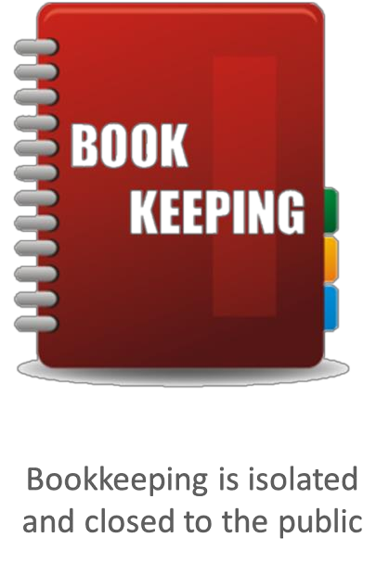
How Trading Happens Using Current System?

Slide 23




Problems with the Current System
Banks and other third partiestake fees for transferring money
Mediating costs increases transaction costs
Minimum practical transaction size is limited; Cutting off the possibility for small casual transactions
Financial exchanges are slow. Checking and low cost wire services take days to complete
System is opaque and lacks transparency and fairness
Also, central authority in control can overuse the power and can create money as per their own will
10$
9.8$
Trusted Third Party
Andy
Derby

Slide 24
Issues in Current Banking System Vs Blockchain Solun.
The issues with the current banking systems are: -
Higher Transaction Fees
Double Spending
Net Frauds and Account Hacking
Financial Crisis and Crashes
Blockchain technology tackles the above-mentioned issues by providing best solutions: -
Decentralized System
Public Ledgers
Verification of Every Individual Transaction
Low or No Transaction Fees

Slide 25
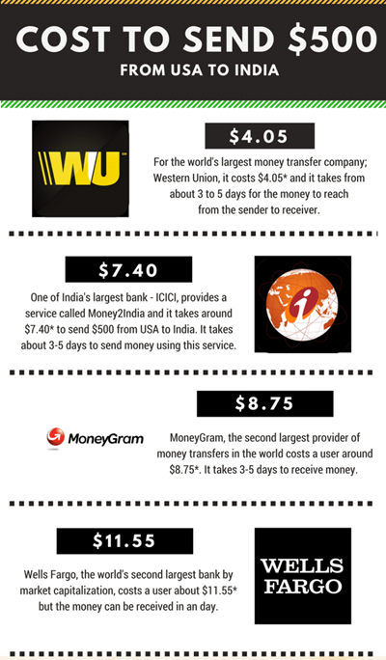
Transaction Fees – Current Trend

Slide 26
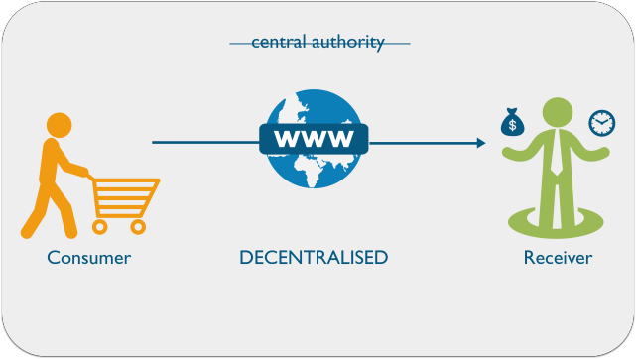
What can be the Possible Solution?
We need a system which:
Eliminates the need of middlemen or Third Parties thereby making transaction costs nil or negligible.
Enhances transaction execution speeds and can facilitate instant reconciliation.
Is Transparent and tamper resistant in order to avoid manipulation or misuse.
Currency creation is not in control of any central authority.
Is regulated to maintain the value of the currency.
Hence, we need a Distributed System

Slide 27
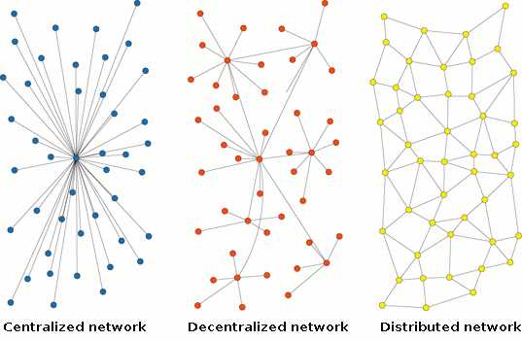
Distributed System attempts to Solve the Problem
Distributed System enables a network of computers to maintain a collective bookkeeping via the internet
This is open and is not in control of one party
It is available in one ledger which is fully distributed across the network

Slide 28
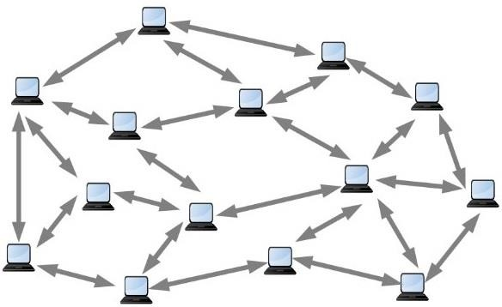
Distributed System
A system where two or more nodes work with each other in a coordinated fashion in order to achieve a common outcome
It's modelled in such a way that end users see it as a single logical platform.
What is a node?
A node can be defined as an individual processing
unit in a distributed system
All nodes are capable of sending and receiving messages to and from each other
Nodes in Distributed System
Distributed System

Slide 29
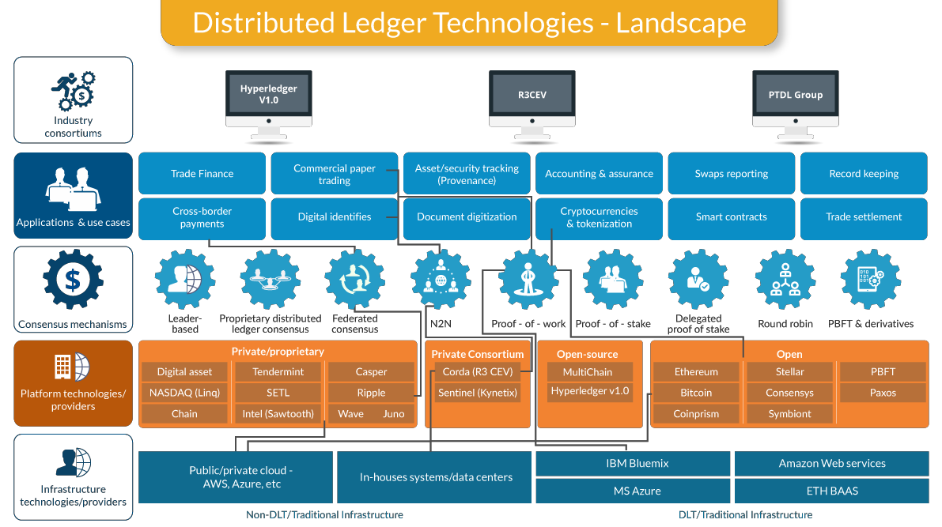
Distributed Ledger Technologies

Slide 30
Most common Cryptocurrency
Bitcoin — The first ever cryptocurrency that started it all.
Ethereum — A Turing-complete programmable currency that lets developers build different distributed apps and technologies that wouldn’t work with Bitcoin.
Ripple — Unlike most cryptocurrencies, it doesn’t use a Blockchain in order to reach a network-wide consensus for transactions. Instead, an iterative consensus process is implemented, which makes it faster than Bitcoin but also makes it vulnerable to hacker attacks.
Bitcoin Cash — A fork of Bitcoin that is supported by the biggest Bitcoin mining company and a manufacturer of ASICs Bitcoin mining chips. It has only existed for a couple of months but has already soared to the top five cryptocurrencies in terms of market cap.

Slide 31
Most common Cryptocurrency..
NEM — Unlike most other cryptocurrencies that utilize a Proof of Work algorithm, it uses Proof of Importance, which requires users to already possess certain amounts of coins in order to be able to get new ones. It encourages users to spend their funds and tracks the transactions to determine how important a particular user is to the overall NEM network.
Litecoin — A cryptocurrency that was created with an intention to be the ‘digital silver’ compared to Bitcoin’s ‘digital gold.’ It is also a fork of Bitcoin, but unlike its predecessor, it can generate blocks four times faster and have four times the maximum number of coins at 84 mlns.
IOTA — This cryptocurrency’s breakthrough ledger technology is called ‘Tangle’ and it requires the sender in a transaction to do a Proof of Work that approves two transactions. Thus, IOTA has removed dedicated miners from the process.
NEO — It’s a smart contract network that allows for all kinds of financial contracts and third-party distributed apps to be developed on top of it. It has many of the same goals as Ethereum, but it’s developed in China, which can potentially give it some advantages due to improved relationship with Chinese regulators and local businesses.

Slide 32
Most common Cryptocurrency..
Dash — It’s a two-tier network. The first tier is miners that secure the network and record transactions, while the second one consists of ‘masternodes’ that relay transactions and enable InstantSend and PrivateSend type of transaction. The former is significantly faster than Bitcoin, whereas the latter is completely anonymous.
Qtum — It’s a merger of Bitcoin’s and Ethereum’s technologies targeting business applications. The network boasts Bitcoin’s reliability, while allowing for the use of smart contracts and distributed applications, much how it works within the Ethereum network.
Monero — A cryptocurrency with private transactions capabilities and one of the most active communities, which is due to its open and privacy-focused ideals.
Ethereum Classic — An original version of Ethereum. The split happened after a decentralized autonomous organization built on top of the original Ethereum was hacked.

Slide 33
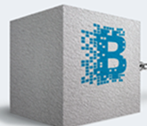
Blockchain Overview

Slide 34

“A Blockchain is a magic computer that anyone can upload programs to and leave the programs to self-execute, where the current and all previous states of every program are always publicly visible, and which carries a very strong crypto economically secured guarantee that programs running on the chain will continue to execute in exactly the way that the Blockchain protocol specifies.” — Vitalik Buterin

Slide 35


Defining Blockchain
Blockchain is a distributed ledger of an immutable record of financial, data or material transactions
Every new record is validated, without a centralized party, across the network before it is stored in a block
A block is the current part of the Blockchain where the recent transactions are recorded
Once all the transactions in a block get verified, it goes into the Blockchain as permanent database
New Blocks
To access data of the first ever created block, you have to traverse from the last created block to the first block
[
First Block
Growing Blockchain

Slide 36


Blockchain is Chain Of Blocks
Blocks are linked to each other like a chain in a proper, time-stamped chronological order
Each block is identified by its cryptographic hash
Blockchain is similar to a linked list where every block contains a hash of the previous block
The first block of the Blockchain is know as the Genesis block.
Previous block hash:
ae2345gta7892ngYH
Transaction 1--------------
Transaction 2--------------
Transaction 3--------------
Block hash:
3gys78kwvU7F98hD9
Genesis Block
Previous block hash: 3gys78kwvU7F98hD9
Transaction 1-------------- Transaction 2-------------- Transaction 3--------------
Block hash: 47bd6RmîU6801AsTr
Previous block hash: 47bd6RmîU6801AsTr
Transaction 1-------------- Transaction 2-------------- Transaction 3--------------
Block hash: qtwn72mciY8FH462Ua

Slide 37
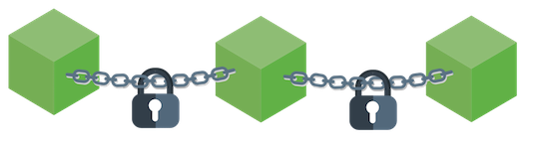
What do you think about Blockchain?
Blockchain is a distributed database
Decentralized P-P network
Maintains a growing list of records in blocks
Each blocks has timestamp and link to previous block (like a linked list)
Data once entered cannot be altered, highly fault tolerant as there is no Single-point-of-failure
Biggest discovery since Internet
Public electronic ledger openly shared among users
Data structure resembles “linked list”
Anonymous, Transparent, auditable, Irreversible, Immutable & hack proof
Technology eliminates the need for middlemen and directly involve both the parties
In short Blockchain is Peer to Peer Network, Distributed Ledger Database, Immutable Database & Transaction Driven

Slide 38
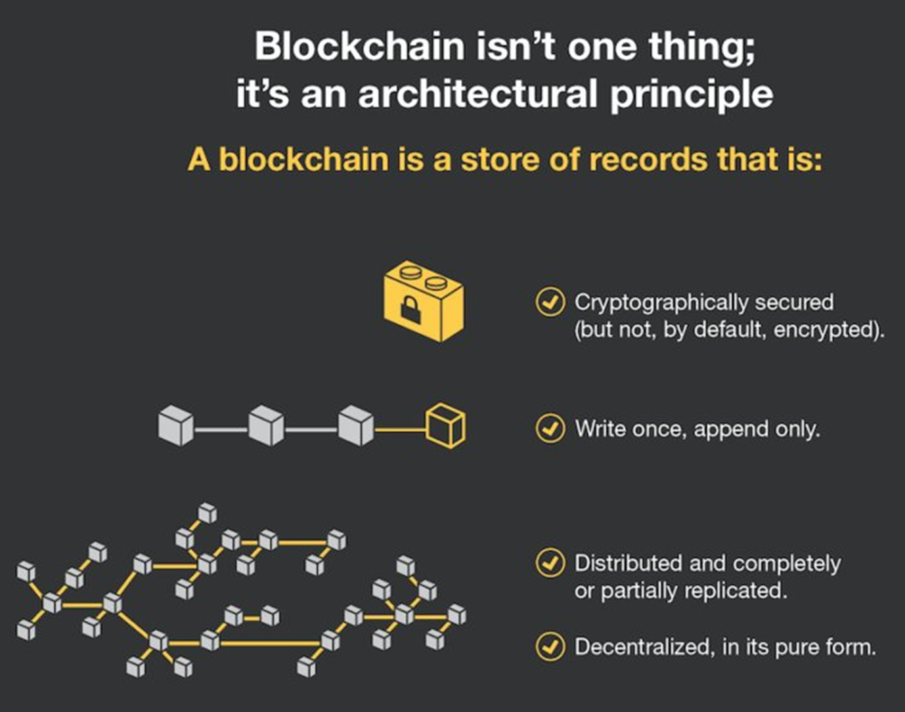
What do you think about Blockchain?

Slide 39

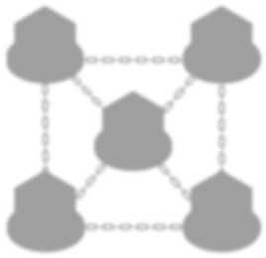
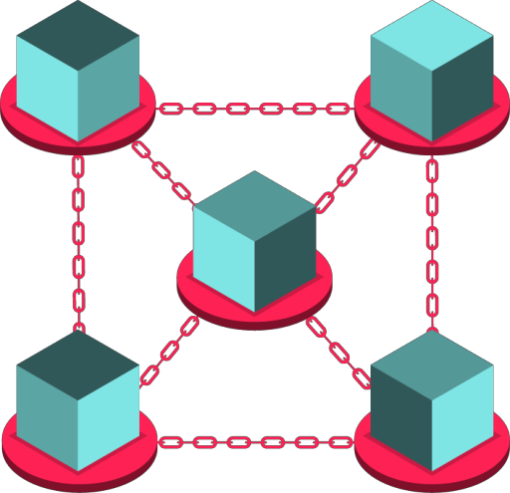
Origin and History of Blockchain
In 2008, Satoshi Nakamoto (An anonymous person or persons), first gestated and implemented the first blockchain database as a infrastructure for the bitcoin, the first cryptocurrency ever created
Satoshi Nakamoto used ‘block’ and ‘chain’ separately in his paper in
October 2008.
Later with time, it became a single word ‘blockchain’

Slide 40
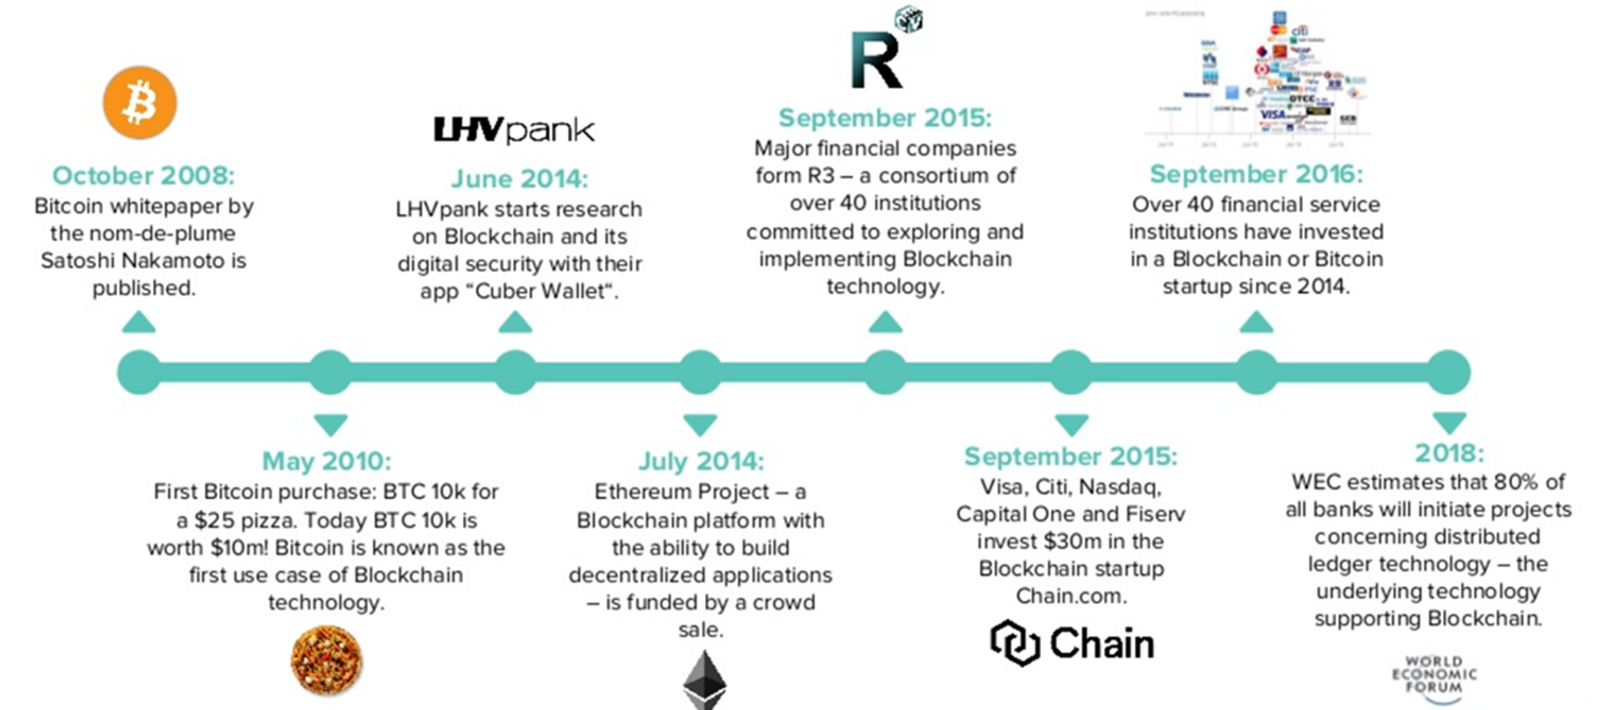
History of Blockchain..

Slide 41
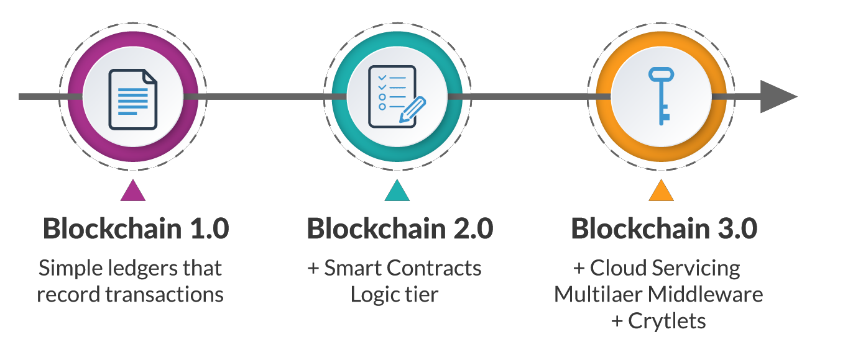
Evolution of Blockchain
Multilayer
Cryptlets
Note: Smart Contracts are unable to access external data or events based on time or market conditions. Calling code or data outside of a Smart Contract or blockchain breaks the general trust barrier and authenticity of transactions. Cryptlets will allow the blockchain to access external data securely, while maintaining the integrity of the blockchain

Slide 42






Blockchain – Flow Diagram
A verified transaction can involve cryptocurrency, contracts, records or anything of a value
Validation
The transaction is broadcast to the P2P network
The network of nodes validate the transaction
Someone requests a transaction
Once verified, the transaction becomes a part of new block for the ledger
The new block is then added to the existing blockchain
The transaction is complete

Slide 43
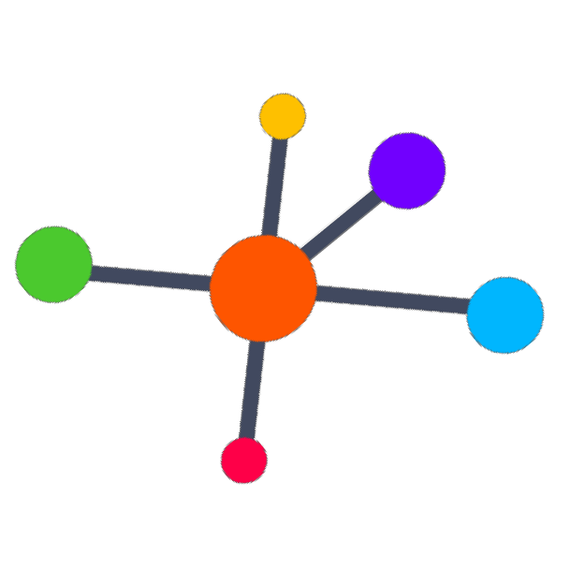
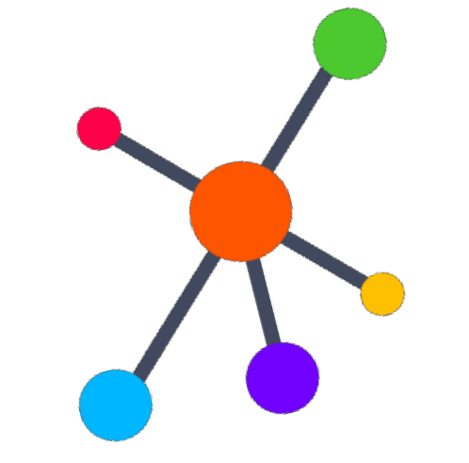
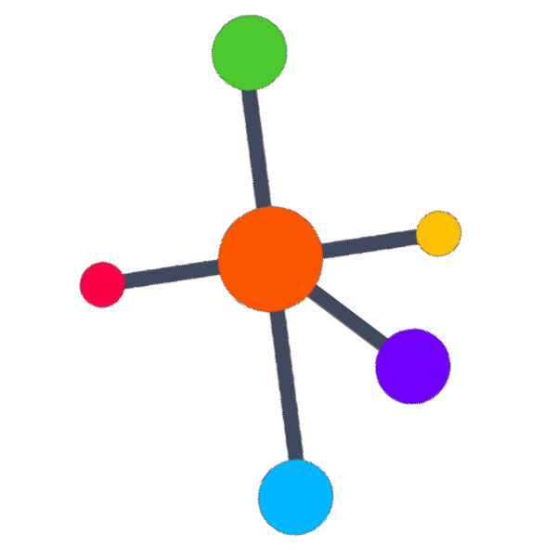
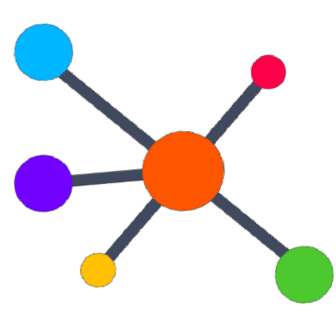
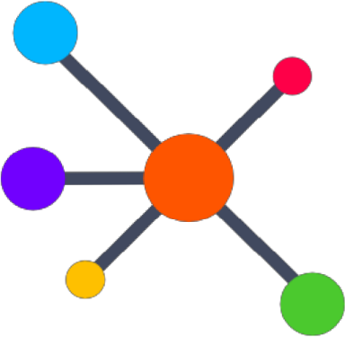

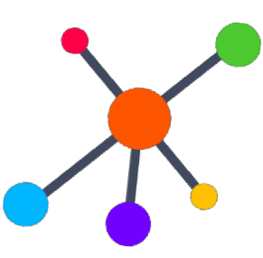
Properties Of Blockchain
In a Blockchain system, a transaction :
Is encrypted by
Asymmetric Cryptography
Is secured by
Consensus Algorithm
Propagates
Peer-to-Peer
Is validated by
Miners Nodes
All these concepts constitute Blockchain Technology
Is stored in a
Secured Ledger

Slide 44
Characteristics of Blockchain
The characteristics of Blockchain are:-
Transparent
Secured
Untamperable

Slide 45

Major Innovations in Blockchain
01
Bitcoin was the FIRST Implementation
of Blockchain
The person or persons who designed bitcoin , as part of the implementation, he/they also devised the first blockchain database
Blockchain was the SECOND innovation
02
It was essentially the realization that the underlying technology used by bitcoin could be separated and used for other operations also
03
The THIRD was the “smart contract”
embodied in a Blockchain 2.0 system
It built little computer programs directly into blockchain that allowed financial instruments
The FOURTH critical innovation is “proof
of stake” 04
Current generation is secured by “proof of
work”. The new system is replacing them with complex financial instruments, for similar or higher degree of security

Slide 46



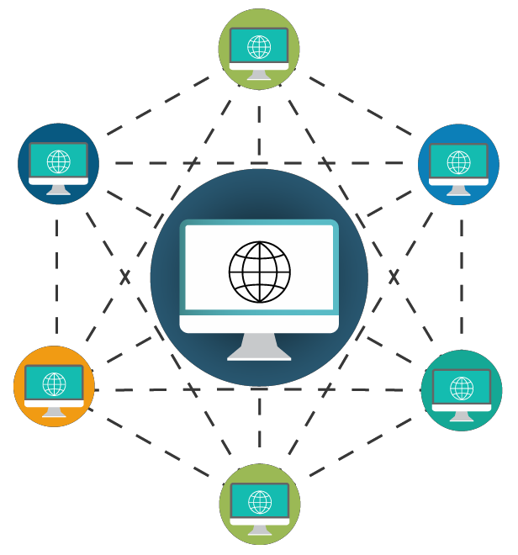

Reasons Why Blockchain is a Disruptive Technology
01
OPEN
Blockchain is open source technology. All the operations are carried out by the open source community
04
SECURE
It is impossible for anyone to tamper with transactions or ledger records present in blockchain
02
WORLDWIDE ADOPTIONTION
Blockchain has been adopted worldwide and has the backing of many investors from banking and non- banking sectors
05
DISTRIBUTED ARCHITECTURE
Blockchain works in a distributed mode in which records are stored in all nodes in the network. If one node goes down, it doesn’t impact any other records
03
AUTOMATED OPERATIONS
Operations are fully automated through software. Private companies are not needed to handle operations
FLEXIBLE
Blockchain is programmable, using basic programming concepts this makes
blockchain flexible
06

Slide 47
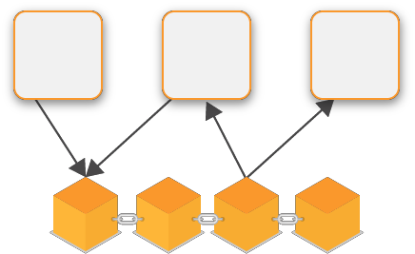
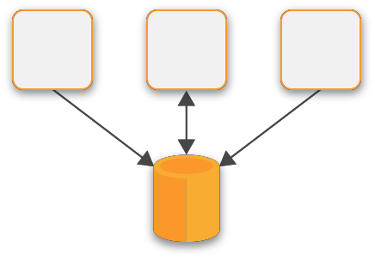
Compare Blockchain v/s Traditional Databases
Blockchain
Traditional Database
Properties | Blockchain | Traditional Database
Operations | Only Insert Operations | Can perform C.R.U.D. Operations
Replication | Full Replication of block on every peer | Master-Slave Multi-master
Consensus | Majority of peers agree on the outcome of transactions | Distributed Transactions (2 Phase Commit)
Invariants | Anybody can validate transactions across the network | Integrity Constraints

Slide 48
Compare Blockchain v/s Traditional Databases
CHARACTERISTICS | ADVANTAGE
Disintermediation | Blockchains
Confidentiality | Centralized databases
Robustness | Blockchains
Performance | Centralized databases
History of itself – Audit Trail | Blockchains
Blockchains do have strong use cases, where disintermediation and robustness are
more important than confidentiality and performance

Slide 49
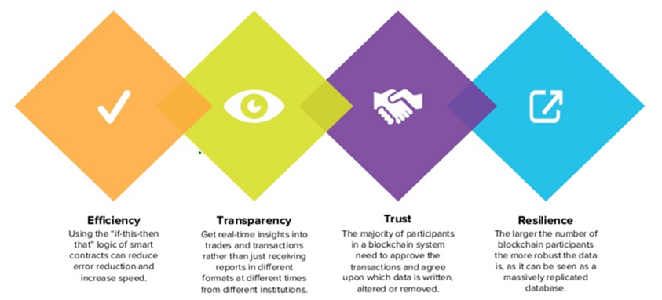
Advantages of Blockchain?

Slide 50
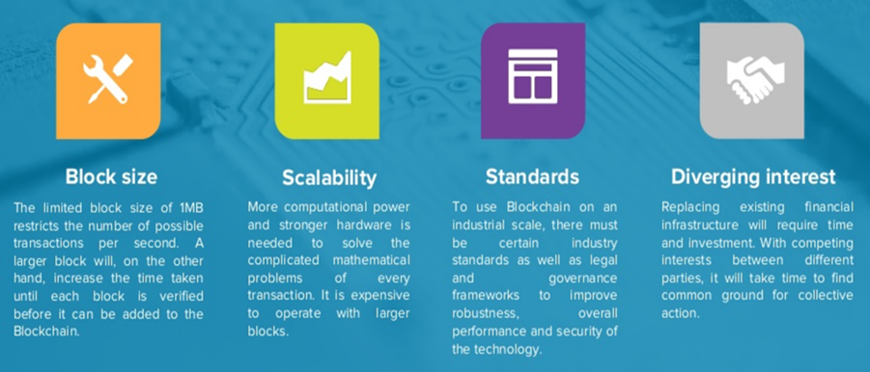
Disadvantages of Blockchain?

Slide 51
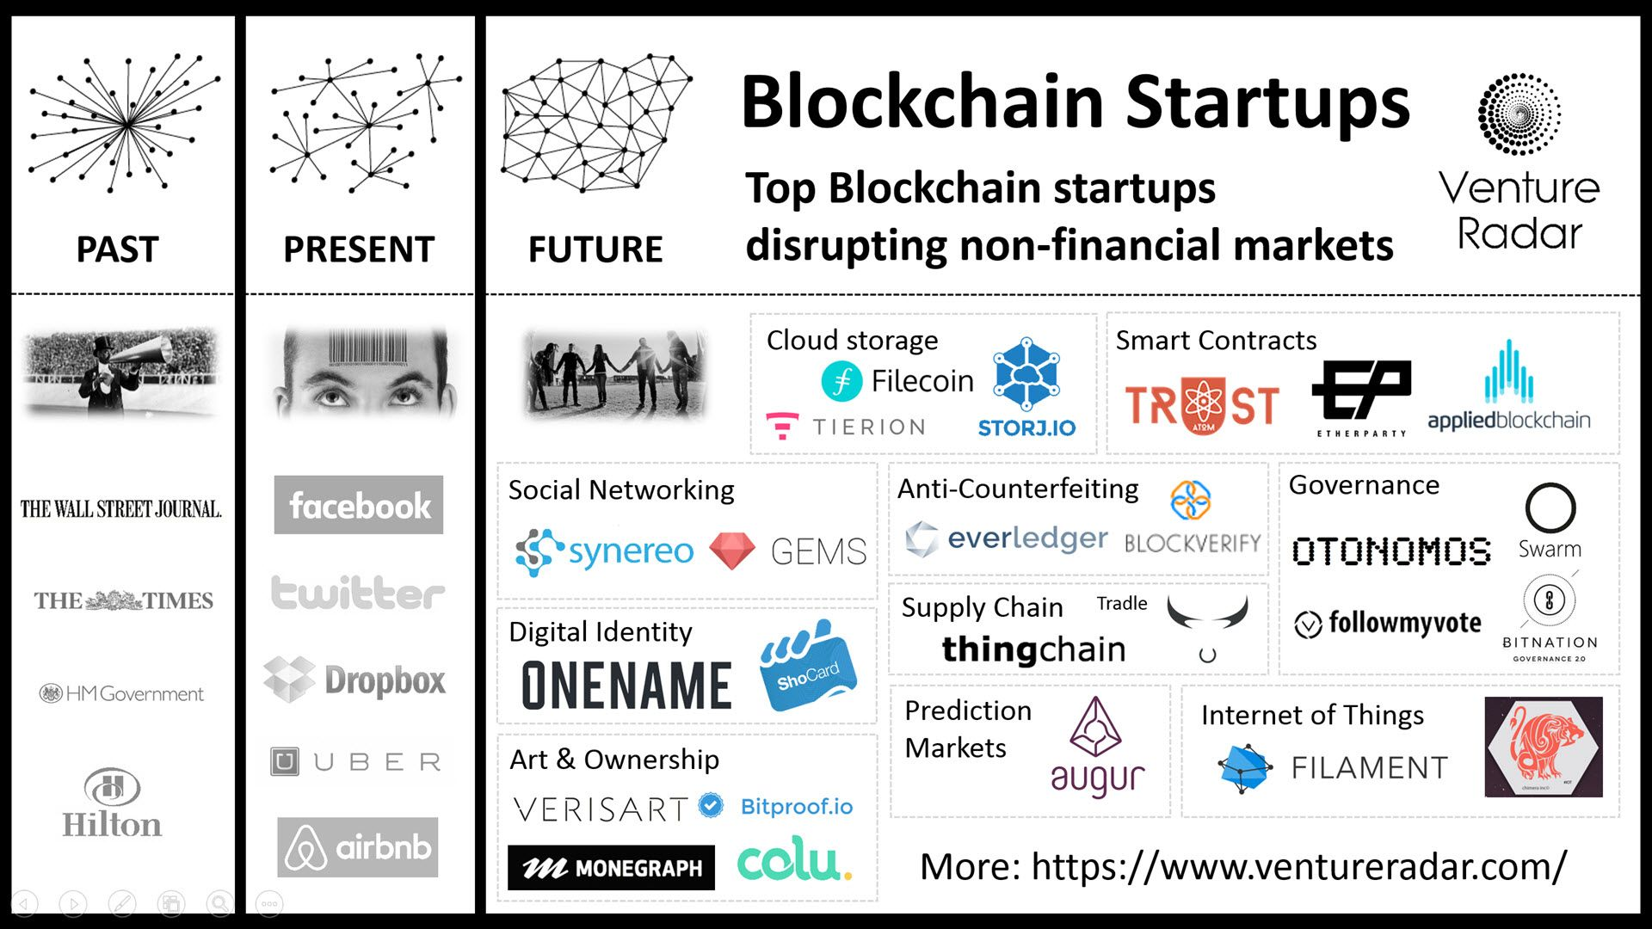
Companies using Blockchain

Slide 52
How does Blockchain works?

Slide 53
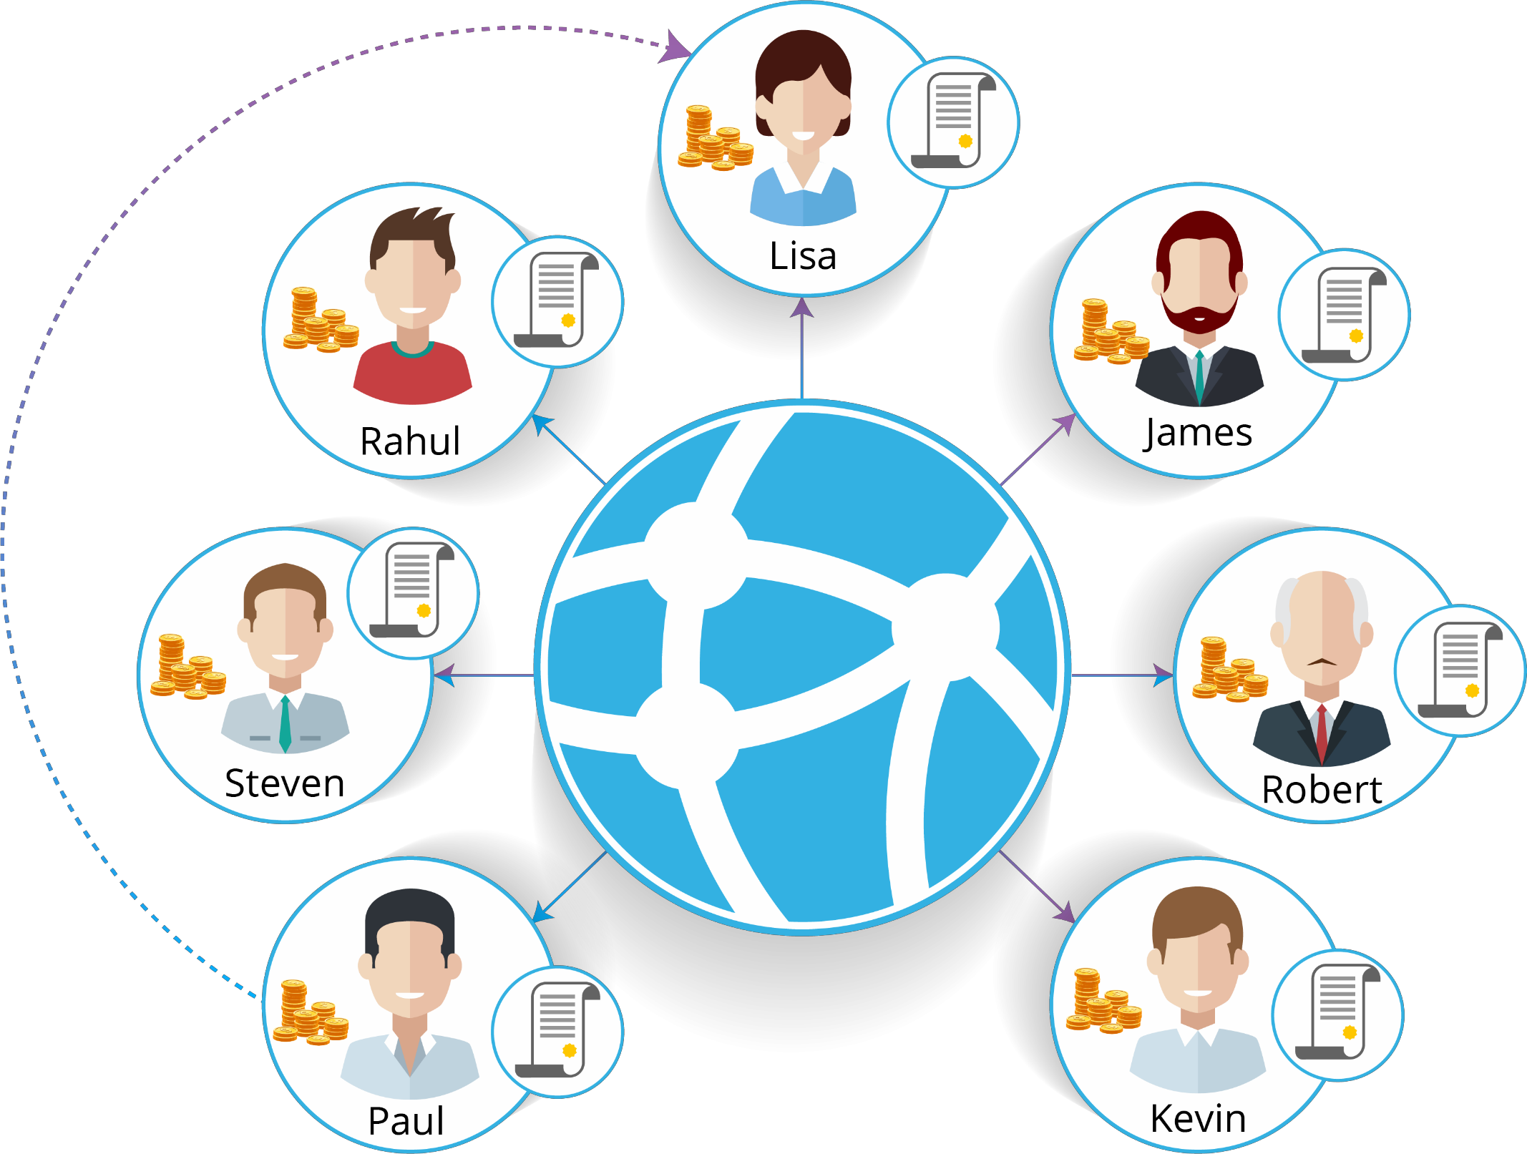
Initiating A Transaction In A Network
Let’s say Paul wants to transfer money to his friend, Lisa.
Both of them are a part of the decentralized Blockchain network.

Slide 54

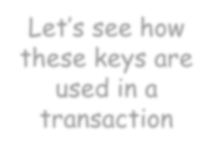








Public Key And Private Key
To initiate a transaction, Paul uses two pieces of information: public key and private key.
Let’s see how these keys are used in a transaction
One key in the pair can be shared with everyone ; it is called the public key
The other key in the pair is kept secret ;
it is called the private key

Slide 55
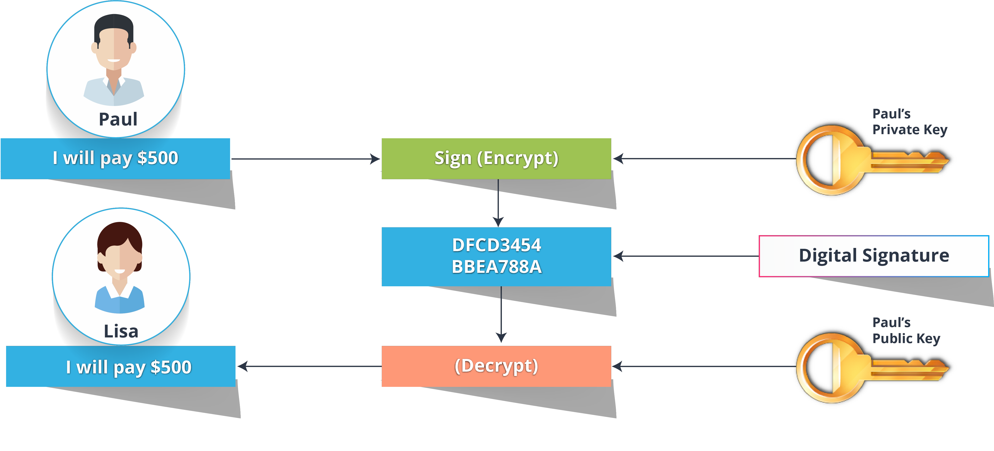
Securing A Transaction

Slide 56




The keys are stored in his Cryptocurrency wallet
Okay, but where does Paul keep these keys?

Slide 57
Cryptocurrency Wallet

Slide 58



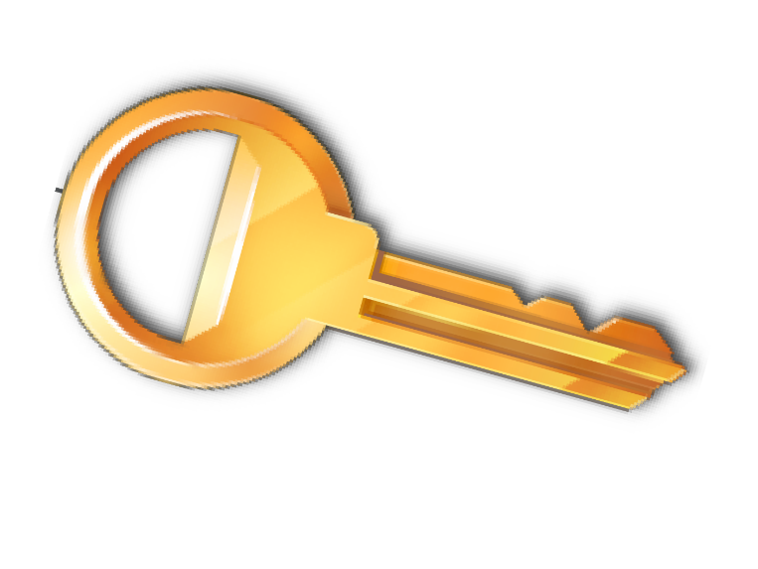


Use Of Cryptocurrency Wallet
When you want to transfer an asset (here cryptocurrency) then you need some place to manage the asset as well as the keys used to sign the transaction
A cryptocurrency wallet is actually a software program that stores Public and Private Keys and also enables the users to send a receive digital currency while keeping track of their balance.

Slide 59






Types Of Cryptocurrency Wallet
Exodus
Exodus is currently only available on the desktop. It enables the storage and trading of Bitcoin, Ether, Litecoins etc through an incredibly easy to use interface. And also offers a very simple guide to backup your wallet.
Copay
Created by Bitpay, Copay is easily accessed through a user-friendly interface on desktop, mobile or online. It’s a multi-signature wallet so friends or business partners can share funds.
Jaxx
Jaxx is a multi-currency Ether, Litecoin, Zcash, Bitcoin wallet and user interface. It is available on a variety of platforms and devices.
Blockchain(dot)info
Blockchain.info provides two different additional layers. For the browser version, users can enable two-factor authentication, while mobile users can activate a pin code requirement every time the wallet application is opened

Slide 60




Sending A Transaction
A transaction/information is broadcasted in the entire network as a digital message
Just like your signature provides the proof of ownership on a document, a digital signature provides the proof that the transaction is genuine
Unlike a handwritten password, that remains the same, a digital signature is unique for every transaction
Digital Signature
0432378488432700328434ea45de65837abfc452
Digital Message
Different Every time

Slide 61


After the transaction is created, it propagates in the Blockchain Network

Slide 62
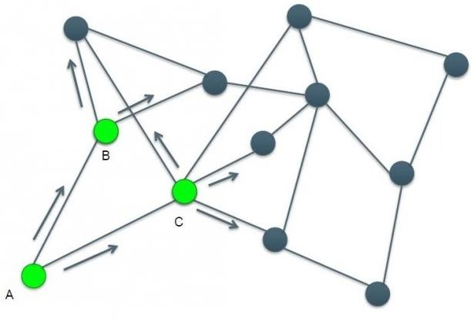
Transaction Propagates In A Distributed Network
In a distributed architecture, transaction is transmitted peer-to-peer
Transmission of the transaction across the network takes around 1-2 seconds
Suppose A (a node in the Network) finds the transaction: Paul pays 5 coins to Lisa.
Node A broadcasts to the Peers B and C in the network.
Nodes (A, B, C) check for the basic formats of the transaction and forward the transaction to their Peers. Like this the transaction propagates rapidly across the network.
Hence it is faster and cost efficient as there is no middle-man

Slide 63


But, when there is no centralized governing party, how do we know that the transactions are authentic?
There are some special nodes in the network that verify the transactions and maintain the ledger.
We call them Miners!

Slide 64
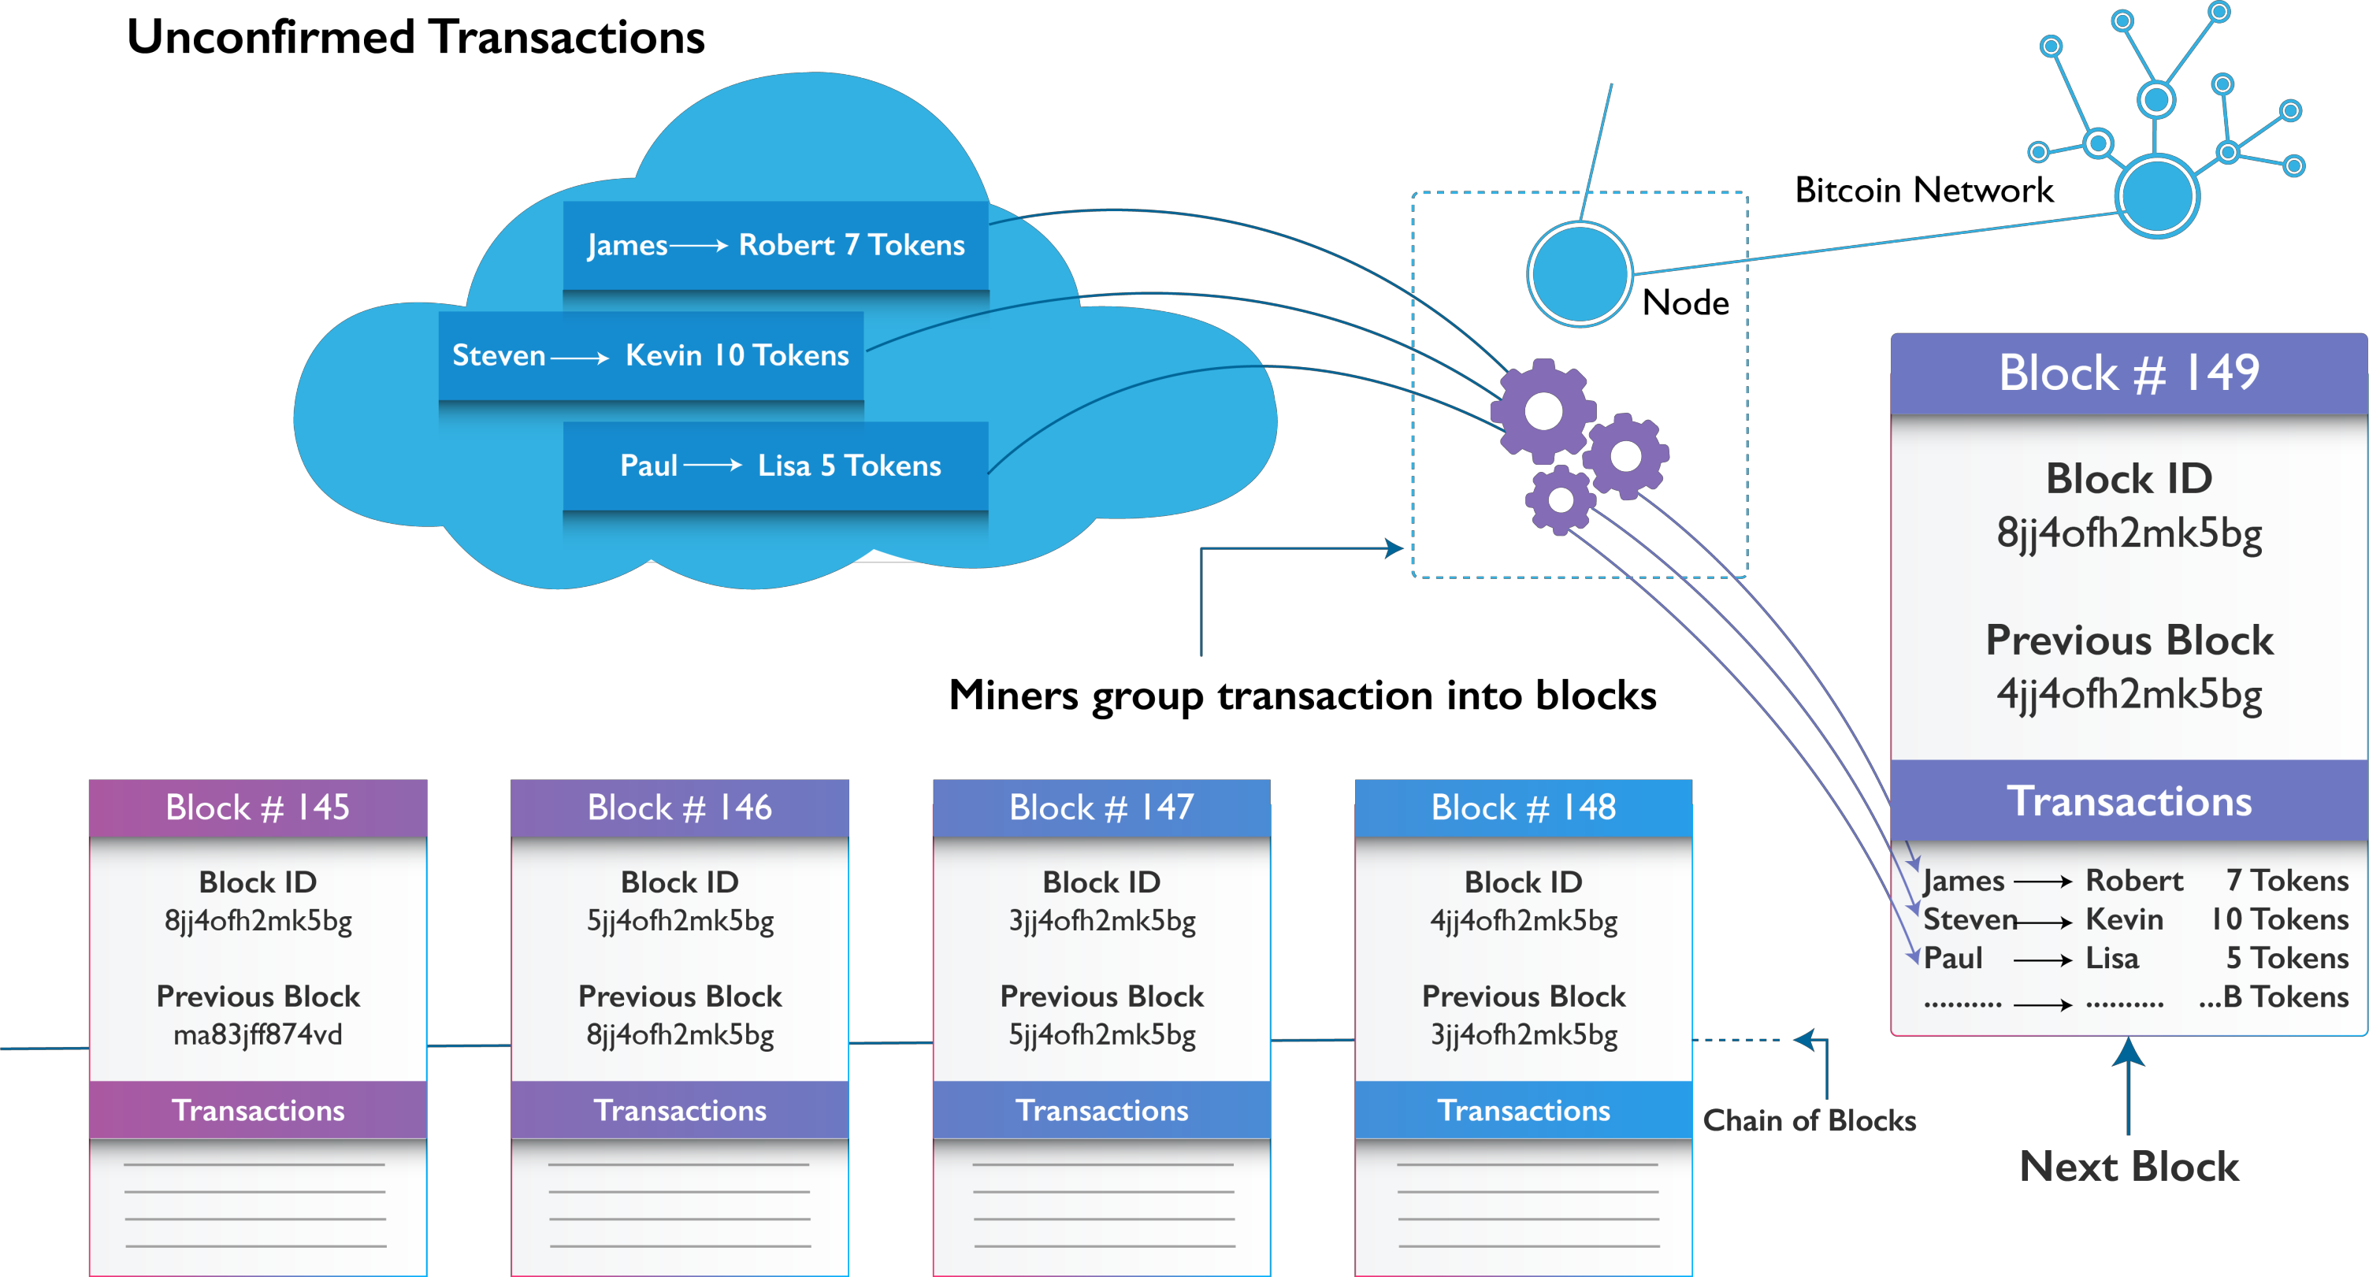
Miners Group The Transactions In A Block
Blockchain Network

Slide 65





Transaction - Flow Diagram
A verified transaction can involve cryptocurrency, contracts, records or anything of a value
Validation
The transaction is broadcast to the P2P network
The network of nodes validate the transaction
Someone requests a transaction
Once verified, the transaction becomes a part of new block for the ledger
The new block is then added to the existing Blockchain
The transaction is complete

Slide 66

Aggregating Transactions Into Blocks
Example: Let’s say Andy is a Miner
A mining node maintains a local copy of the Blockchain and the list of all blocks created ever since the beginning

Slide 67













Aggregating Transactions Into Blocks
As his node is mining, it receives block (say 273816) through the Blockchain network. The arrival of this block signifies the end of the competition for the block.
During the previous time his node was searching for a solution to block (273816) , it was also collecting transactions in preparation for the next block (273817)
Andy’s node is listening for transactions, trying to mine a new block and also listening for blocks discovered by the other nodes.
As his node is mining, it receives block
(say 273816) through the Blockchain network. The arrival of this block signifies the end of the competition for the block.
During the previous time his node was
searching for a solution to block (273816) , it was also collecting transactions in preparation for the next block (273817)
Andy’s node is listening for transactions,
trying to mine a new block and also listening for blocks discovered by the other nodes.
Now his node will validate the block (273816) and also check all the transactions in the memory pool to remove any if included in block (273816)
Now his node will validate the block
(273816) and also check all the transactions in the memory pool to remove any if included in block (273816)
Whatever transactions are left in the memory pool remain unconfirmed waiting to be recorded in a new block.
By now it has collected a few hundred transactions in the memory pool
Whatever transactions are left in the
memory pool remain unconfirmed waiting to be recorded in a new block.
By now it has collected a few hundred
transactions in the memory pool
Andy’s node immediately constructs a candidate for block (273817) . This block is called a Candidate Block because it is not yet a valid block, as it does not contain a valid proof of work.
Andy’s node immediately constructs a
candidate for block (273817) . This block is called a Candidate Block because it is not yet a valid block, as it does not contain a valid proof of work.
The block becomes valid only if the miner succeeds in finding a solution to the proof-of-work algorithm.
The block becomes valid only if the
miner succeeds in finding a solution to the proof-of-work algorithm.

Slide 68





If there can be a number of miners constructing a block, then whose block is chosen by the network??
Answer to all your confusions is Consensus Algorithm!
What will happen to other blocks constructed by other miners if one of them wins??
What will happen if a node in the network tries to cheat the system??

Slide 69

Consensus Algorithm

Slide 70
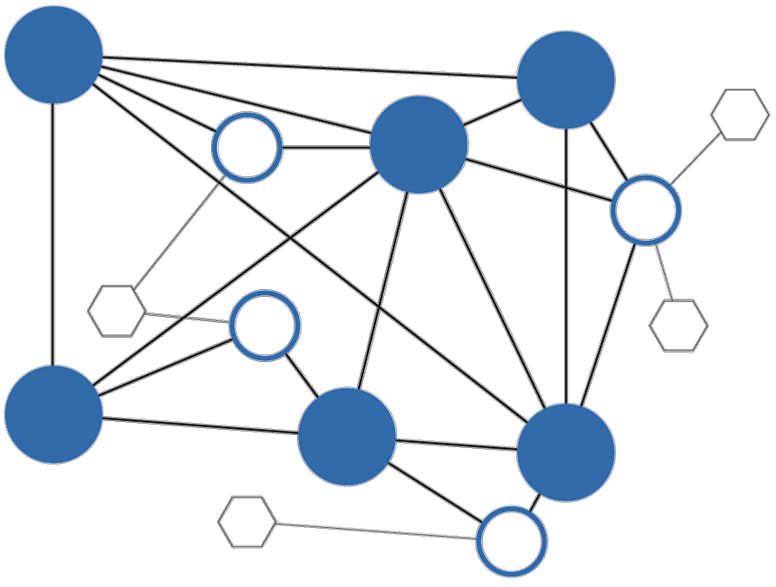
Consensus
Provides the technical infrastructure layer for blockchains. This makes it one of the most critical components when assessing real-world use cases
Consensus does two things:
01
02
It ensures that the next block in a blockchain is the one and only version of the truth
It keeps powerful adversaries from derailing the system

Slide 71
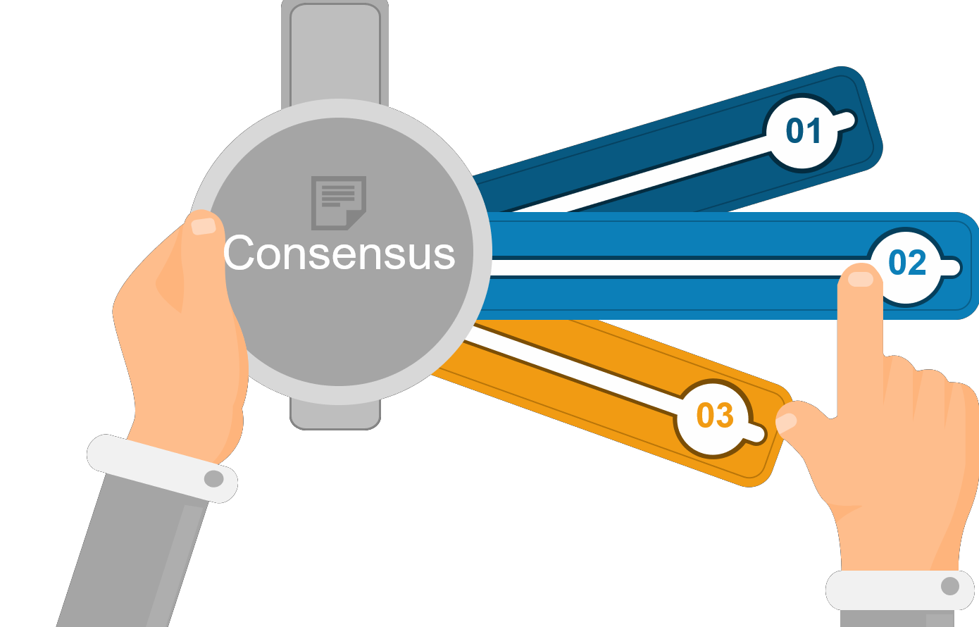
Consensus Algorithm
Consensus algorithms are central to the functioning of any Blockchain
There is a contradiction among the nodes about the blocks in the network, such a contradiction is resolved by the Consensus rules
Consensus is the task of getting all processes in a group to agree on some specific value based on the votes of each processes
01
02
With a consensus algorithm, we need to get unanimous agreement
Any algorithm that relies on multiple processes maintaining common state relies on attaining a consensus
03

Slide 72
Consensus Algorithm
What is Consensus Algorithm ?
Consensus algorithm (Consensus Protocol / Consensus mechanism)
Algorithm to reach agreement
All nodes should agree about the changes
Fault Tolerance
Behavior of intentionally corrupt nodes
Honest nodes should win
Too much resources should be required for successful attack
Every one on the N/W can verify next block’s correctness

Slide 73








Basic Parameters that Define a Consensus Mechanism
Decentralized Consensus
A single central authority cannot provide transaction finality
1
Performance
It considers throughput, liveness, latency
Quorum Structure
Nodes exchange messages in predefined ways, which may include stages or tiers
8
2
Fault Tolerance
The network operates efficiently and quickly even if some nodes fail or are
slow
Privacy
This provides means to verify that the supposed sender really sent the message
Authentication
Process provides means to verify the participants identities
7
Consensus
3
4
Integrity
It enforces the validation of the transaction integrity
6
5
Non Repudiation
This provides means to verify that the supposed sender really sent the message

Slide 74
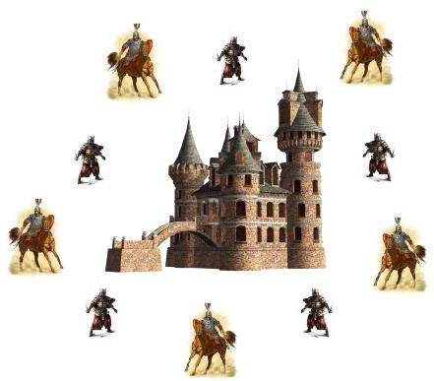
Consensus Story
Byzantine General Problem
Each division of Byzantine army are directed by its own general
Generals, some of which are traitors, communicate with each other by messengers
All loyal generals decide upon the same plan of action
A small number of traitors cannot cause the loyal generals to
adopt a bad plan
All loyal generals receive the same information upon which they will somehow get to the same decision
The information sent by a loyal general should be used by all the other loyal generals
Results
No solution exists if less than or equal to 2/3 generals are loyal

Slide 75

Solution to Byzantine General Problem
Various computer scientists have outline a number of potential solutions to the Byzantine generals problem from the allegory. The practical byzantine fault tolerance algorithm (PBFT), which is used to establish consensus in blockchain systems, is only one of those potential solutions

Slide 76
PBFT
The solution came in 1999, when Miguel Castro and Barbara Liskov introduced the PBFT algorithm
PBFT can process an enormous number of direct peer-to-peer messages with minimal latency
How it works:
Each ‘node’ maintains an internal state
When a ‘node’ receives a message, they use the message in conjunction with their internal state to run a
computation or operation
This tells the node what to think about the message in question
After reaching the individual decision the nodes shares that decision with all other nodes in the system
A consensus decision is determined based on the total decisions submitted by all nodes
This method of establishing consensus requires less effort than other method

Slide 77



Why We Need Different Consensus Algorithms?
Following are the possible reasons why we need consensus algorithms other than proof-of-work:
Different Business Needs/Use Cases
01
05
Performance
Cryptography/Strength of Algorithm
02
06
Tokenization
03
Regularization Requirements
07
Security
04
Implementation
08
Privacy
Following are the possible reasons why we need consensus algorithm more than “proof-of-work” :
Different business needs
Different use cases

Slide 78


Other Consensus Algorithms
05
Scalable BFT
01
Proof-of-Stake (PoS)
06
Ripple Consensus
02
Proof-of-Elapsed-Time (PoET)
07
Stellar Consensus
03
Proof-of-Authority (PoA)
IOTA’s Tangle Consensus
Raft
04
PBFT (Practical Byzantine Fault Tolerance)

Slide 79




Do you know any consensus algorithm?
One of the most popular consensus algorithms is Proof-of-Work (PoW)

Slide 80
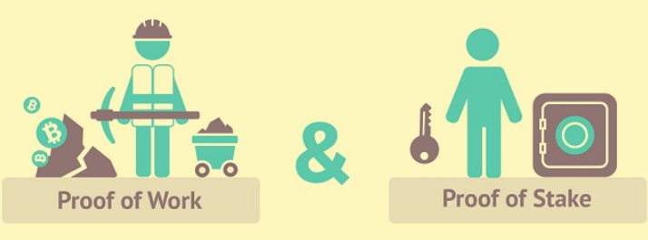
Proof-of-Work & Proof-of-Stake

Slide 81
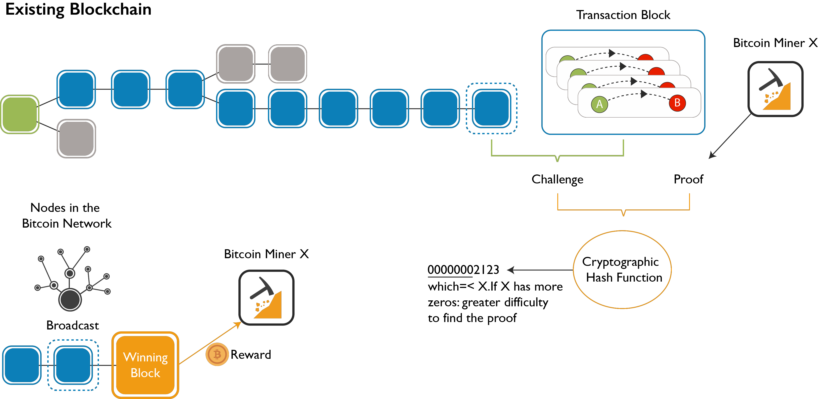

Illustrating The Proof-of-Work
Miner X
Nodes in the Blockchain Network
Miner X

Slide 82
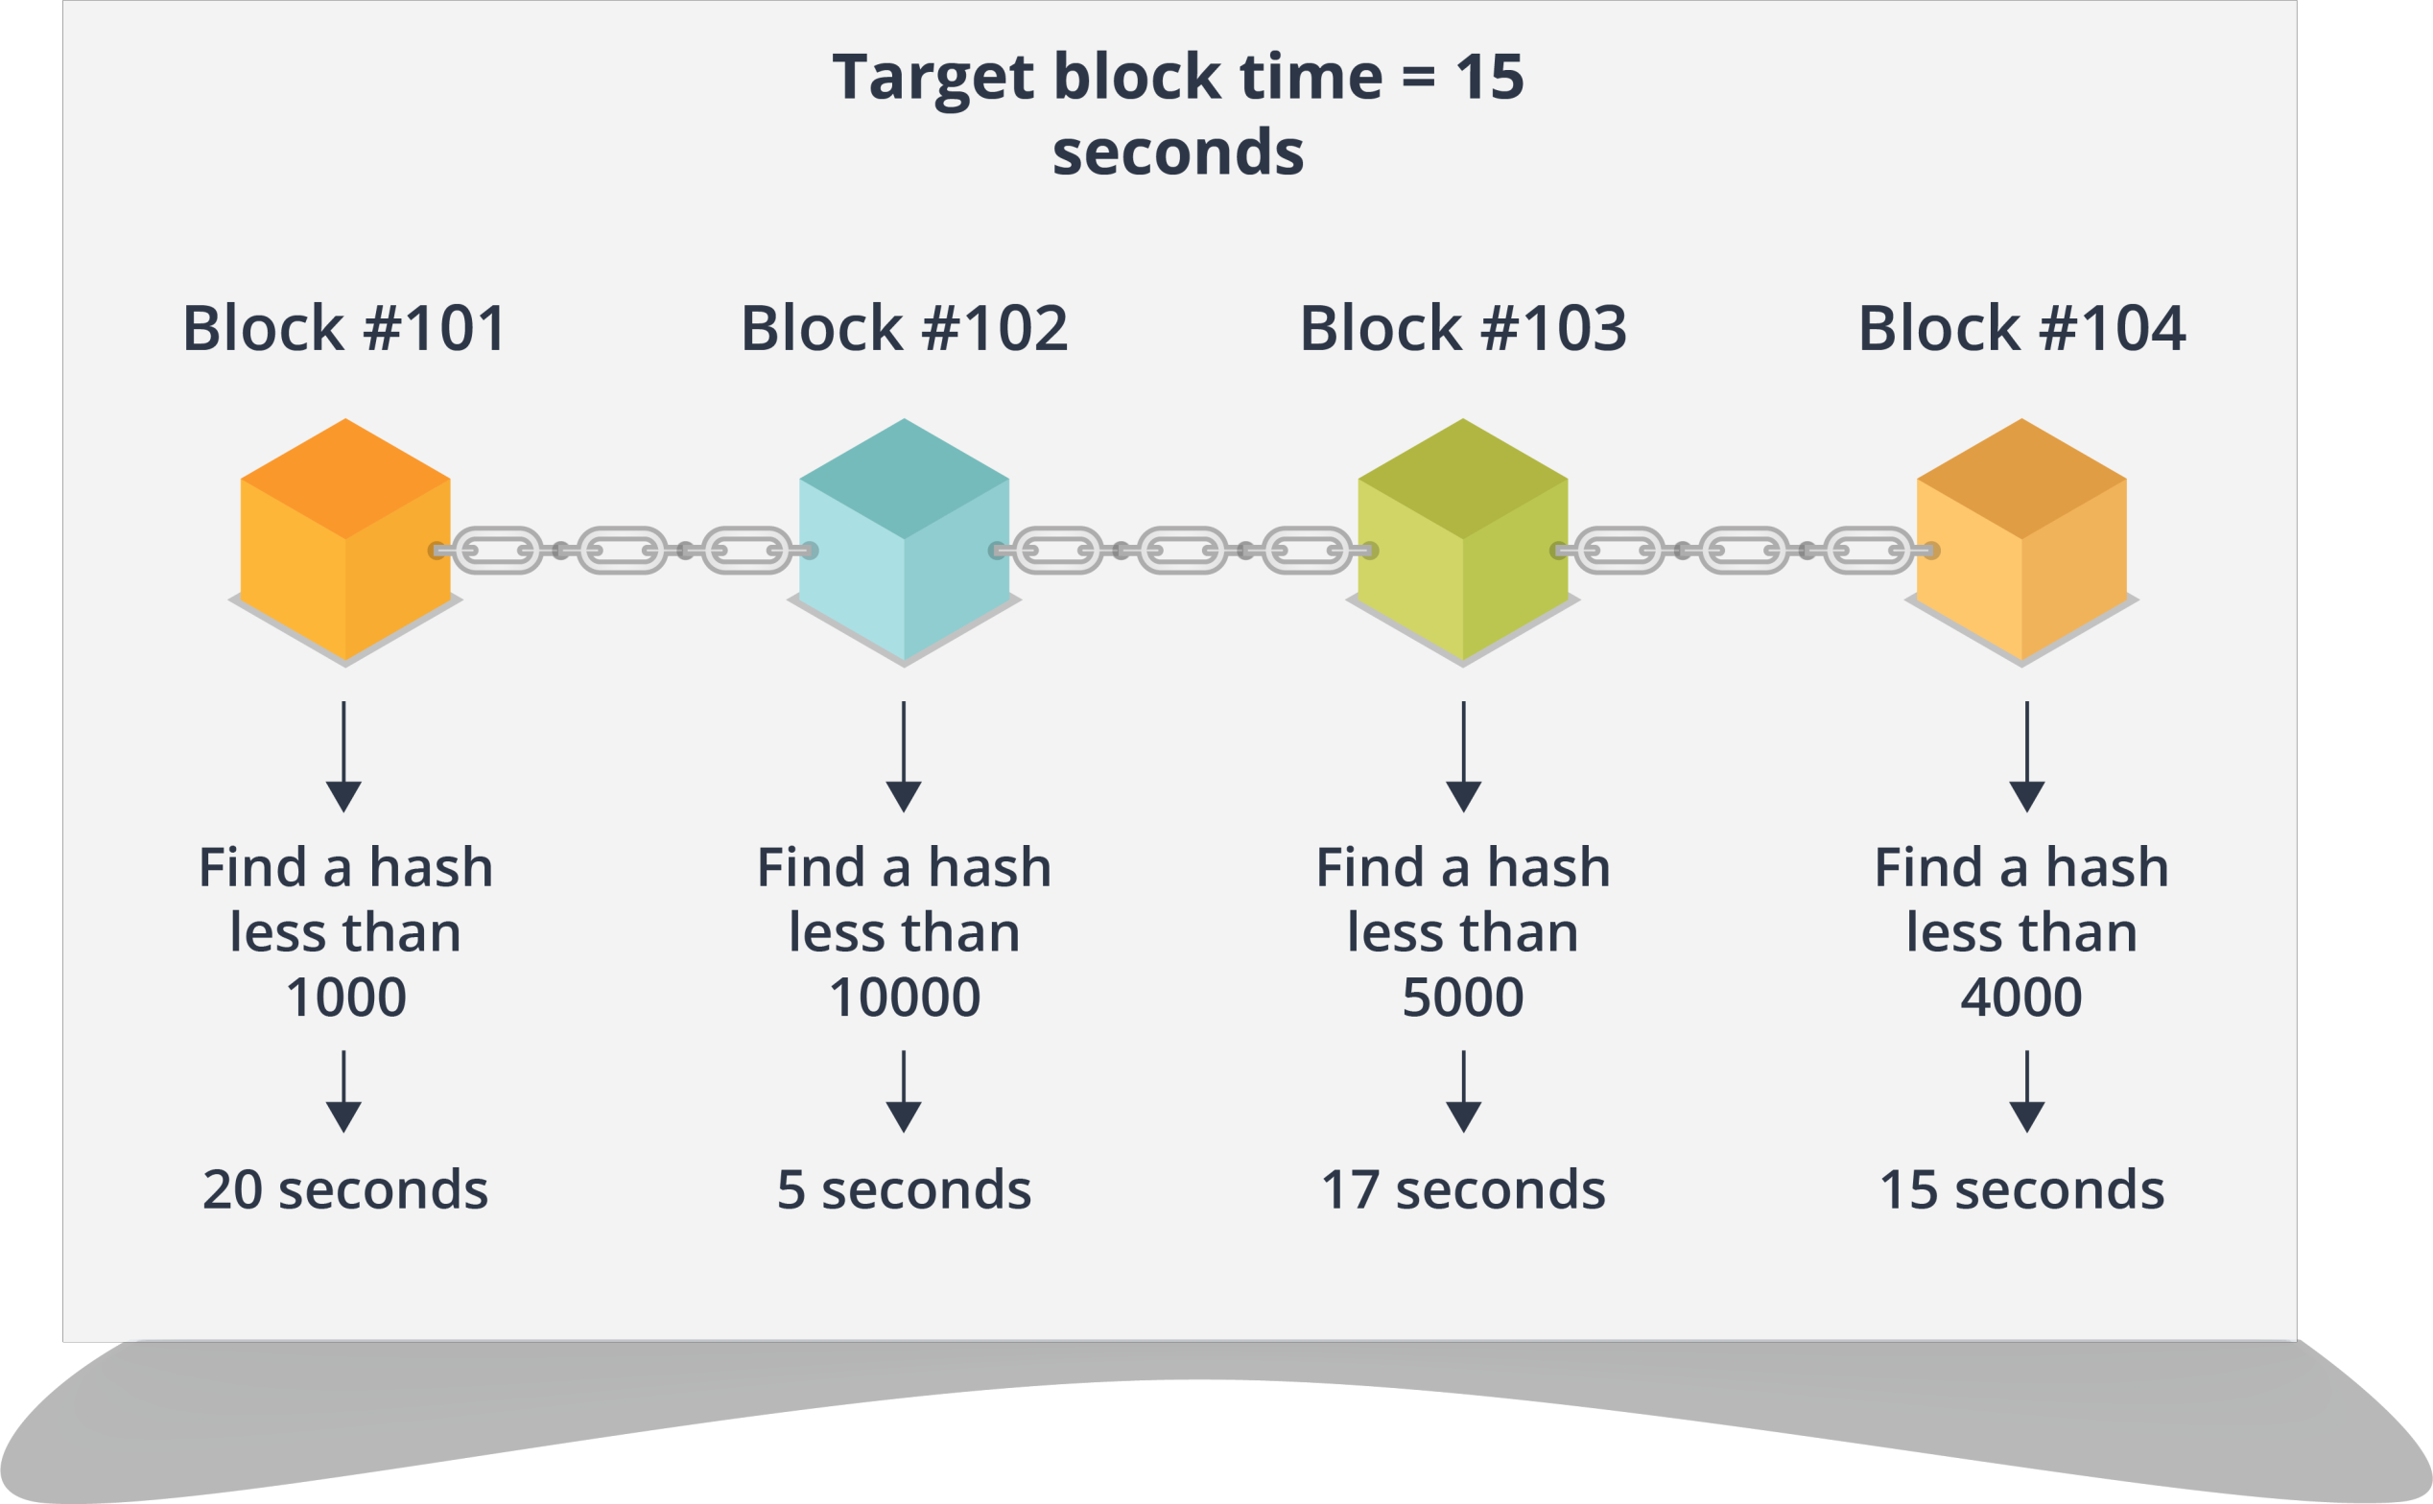


Block Time
The target block time varies for different Blockchain!

Slide 83
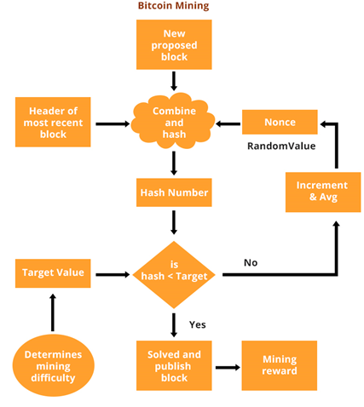



Proof of Work – illustration
Random number is Nonce
Miners tries to find the Nonce
Once found Nonce is broadcasted for verification
1st miner to find the nonce will earn rewards
Currently this bounty is 12.5 bitcoins; this value will halve every 210,000 blocks

Slide 84

Proof of Work – Discussion
More on POW
A POW is a piece of data which is
difficult to reproduce
Easy for others to verify
Producing the POW can be
random guessing process (or)
Can be organized in mining pools (Joint POW production)
Example
Finding a number X, such that SHA256(text+X) has 10 leading zeros
10 Zeros = = network difficulty
Difficulty will get adjusted if the network is smart enough

Slide 85

Proof of Work – Coins
Popular Blockchain's using POW
Bitcoin, Bitcoin Cash, Ethereum, Ethereum Classic, Zcash, Bitcoin Gold, Monero, Litecoin, Dogecoin, Dash

Slide 86
Proof of Work – Problems
Needs computing power
Computationally expensive
Energy intensive
51% attack
Attackers holding more than 50% of the power could potentially reverse-back transactions (double-spend money) / deny service
Transaction Speed
9-10 min
Business needs real-time transactions (milliseconds)
Transaction Speed – Transactions per second (tps)
Bitcoin block size is 1MB
2000-3000 / transactions per block 3-5 tps
Business needs thousands tps (e.g. VISA performs 2000 tps)

Slide 87



Proof of Work – 51% Attack
51% attack
Occurs when a user or a group of users control the majority of mining power.
Monopolize generating new blocks and receive rewards
Also a transaction can be reversed
Further the attackers will mine faster and their fake chain grows longer
In the network, a branch that lasts longer remains, and shorter one is rejected
More on 51% attack
51 percent attack is not a profitable option
Requires an enormous amount of mining power

Slide 88

Proof of Work – Cost of a 51 % Attack

Slide 89

Why you can’t cheat at Bitcoin

Slide 90

Proof-of-Stake
PoS is designed to increase network security and reduce resource wasting
The creator of the next block is chosen in
Combinations of random selection and wealth
E.g. holding 1% of the coins gives the chance to verify (mine) 1% of the “POSblocks“
The "Monopoly Problem": a monopolist (holder of the most Coins) could double spend or deny / filter other's transactions
Executing a monopoly attack is much more expensive than in PoW

Slide 91

Proof-of-Stake
From PoW to PoS Consensus
Proof-of-stake (PoS) Blockchain's either
Start from a PoW algorithm to mine initial amounts of currency Then switch to
proof-of-stake, relying on the mined stakes
Example: Cardano
Or fork existing PoW Blockchain with all its transactions, then switch to PoS-based consensus
Example: PIVX (pivx.org) forked from Dash
Or run a hybrid PoW + PoS consensus mechanism
Popular POS Blockchains
Cardano
Qtum
PIVX
EOS

Slide 92

PoW Vs PoS

Slide 93


Proof-of-Stake
Proof-of-stake, the creator of a new block is chosen in a deterministic
way, depending on its wealth, also called stake
No coin creation exists in proof-of-stake hence a validator invests in
the coins of the system
Your chance of being picked to create the next block depends on the fraction of coins in the system you own
Different proof-of-stake systems vary in how they handle commitment of the created block to the blockchain
A participant with nothing to lose has no reason not to behave badly. This is called nothing at stake problem.

Slide 94

Proof-of-Work v/s Proof-of-Stake

Slide 95
Delegated Proof-of-Stake
Fastest, most efficient, most decentralized, and most flexible consensus model available
All network parameters, from fee schedules to block intervals and transaction sizes can be tuned via elected delegates
Deterministic selection of block producers allows transactions to be confirmed in an average of one second
The consensus protocol is designed to protect all participants against unwanted regulatory interference

Slide 96
Proof-of-Elapsed Time
Intel developed its own alternative consensus protocol called proof-of-elapsed time
System is similar to proof of work but consumes less electricity
The algorithm uses a Trusted Execution Environment (TEE) – such as Software Guard Extensions (SGX) – to
ensure blocks get produced in a random lottery fashion, but without the required work
The approach is based on a guaranteed wait time provided through the TEE
Example : (PoET) is used by HYPERLEDGER SAWTOOTH

Slide 97
Proof of Elapsed Time - Advantages
For the purpose of achieving distributed consensus efficiently, a good lottery function (PoET) has several characteristics:
Fairness:
The function should distribute leader election across the broadest possible population of participants
Investment:
The cost of controlling the leader election process
should be proportional to the value gained from it
Verification:
It should be relatively simple for all participants to verify that the leader was legitimately selected

Slide 98
What If Someone Tries To Hack The System?
What if somebody tries to alter the transaction in the block?
Once a block is solved the cryptographic hash output becomes the identifier of that block
Block Contents
Prev block ID
Transaction
Random guess
Hash Output
If someone tries to alter any transaction in any of the block , the hash of the block changes

Slide 99
Public Key Infrastructure

Slide 100

Public Key Cryptography
This approach involves two different keys
One key is purposely kept private, the other is provided to the other party (or often the public)
If you use private key to encrypt, then the public key can decrypt
If you use the public key to encrypt, then you use the private key to decrypt. This is called asymmetric encryption

Slide 101
Cryptography Algorithms
Blowfish
Known for its speed and effectiveness symmetaric cipher splits messages into blocks of 64
3
RSA
bits and encrypts them individually
RSA is a public-key encryption algorithm and the standard for encrypting data sent over the internet
2
Twofish
Like blowfish, twofish is also a symmetric technique with keys of length 256 bits
4
Triple DES
Triple DES uses thre individual keys with 56 bits each. The total key length adds up to 168 bits
1
5
AES
Uses keys of 192 and 256 bits for heavy duty encryption purposes. It is largely considered impervious to all attacks

Slide 102
Discussing RSA
RSA is a widely used encryption algorithm in
blockchain technology, let’s discuss RSA algorithm extensively

Slide 103

RSA Algorithm

Slide 104

Security of RSA
There are different approaches used in attacking the
RSA algorithm:
Brute force: It involves all possible secret keys
Mathematical attacks: In mathematical attack we are using different techniques, which is similar in effort to factor the product of two primes

Slide 105
Blockchain Ecosystem

Slide 106

Blockchain Ecosystem

Slide 107

Four Main Components of a Blockchain Ecosystem
To implement blockchain we need following four components:
Blockchain Ecosystem
Node Application
Shared Ledger
Consensus Algorithm
Virtual Machine
However, according to the implementation, one or two of these components might differ, for example bitcoin does not uses any virtual machine but Ethereum has a virtual machine

Slide 108



Components of Blockchain Ecosystem Explained
NODE APPLICATION
Each Node have to install and run a computer application definitive to the ecosystem they wish to participate in.
Example- In bitcoin ecosystem, each
computer must be running the bitcoin wallet
SHARED LEDGER
A data structure(Ledger) is managed inside the node application. Contents for the ecosystem can be viewed, once the node application is in running state
CONSENSUS ALGORITHM
Implemented as part of the node application. Provides the rule for how the ecosystem will arrive at a single view of the ledger
VIRTUAL MACHINE
An abstraction of a machine operated with instructions and Implemented as part of the node application that every participant in the ecosystem runs

Slide 109
Blockchain Platforms

Slide 110








Platforms For Implementing Blockchain
Ethereum: An open Blockchain platform that lets anyone build and use decentralized applications that run on Blockchain technology
Multichain: A platform for the creation and deployment of private Blockchains within or between organizations
Openchain: Well suited for organizations
wishing to issue and manage digital assets
IOTA: A revolutionary new block-less distributed ledger which is scalable, lightweight and allows transfer of value without any fees
Chain: Yet another Blockchain platform well suited for financial applications and based on Chain Core which is an enterprise software product
Hyperledger: It is an open source collaborative effort created to advance cross-industry Blockchain technologies

Slide 111





Platforms For Implementing Blockchain (Contd…)
BigChainDB: An open source system that works with Blockchain characteristics of decentralized control, immutability and the transfer of digital assets
Quorum: An open source distributed ledger and smart contract platform based on Ethereum
Stellar: An open-source payment infrastructure that provides HTTP API servers connected to Stellar Core, the backbone of the Stellar network
Corda: A distributed ledger platform with pluggable consensus

Slide 112
Compare Popular Blockchain Implementations
CHARACTERISTICS | ETHEREUM | HYPERLEDGER FABRIC V1.0 | R3 CORDA
Platform | Generic | Modular | Specialized
Management/ Governance | Ethereum Foundation | Linux Foundation | R3
Consensus | Mining based Proof of work(PoW) | Broad understanding of consensus allowing multiple approaches | Specific understanding of consensus(i.e notary nodes)
Level Of Consensus | Ledger level | Transaction level | Transaction level
Smart Contracts | Smart contract code(e.g solidity) | Smart contract code(e.g Go, Java) | Smart contract code(e.g Kotlin, Java, Smart legal contract)
Currency | Ether or Tokens via smart contracts | Currency and Tokens via chaincode | None

Slide 113
Blockchain Applications

Slide 114






Blockchain Applications
Followmyvote is the world’s first open-source online voting solution based on Blockchain & helps in voter identification & online voting
ShoCard stores your identity onto Blockchain for easy verification. Can be used for Governmental schemes and bank verification
Aracade City is a true decentralized ride-sharing service often called ‘Uber killer’. Works on real time carpooling technique based on Blockchain.
Everledger provides an immutable Blockchain ledger for diamond identification and transaction verification.
Brooklyn Microgrid allows local residents to buy and sell the energy on Blockchain they produce from rooftop solar power installations.
Bitshares provides a high-performance decentralized trading platform on Blockchain

Slide 115
Blockchain Applications..
Currency - Bitcoin began as a P2P electronic cash system. Anyone can hold bitcoin and pay anyone without a middle man. Examples: Bitcoin, Litecoin. As a result a number of banks, including Deutsche Bank, Barclays and Santander, have started exploring blockchain’s potential to make payments faster, cheaper and more transparent.
Trading - Nasdaq started using Blockchain technology in its private stock market, one of the world’s largest, and potentially shake up systems that have facilitated the trading of financial assets for decades. Blockchain will revolutionize banking domain.
Smart Contracts - There are lot of agreements and contracts that will be signed in various deals. For example, in Real estate to avoid the risk and forgery in executing a deal, Blockchain helps us a lot. It keeps track of the ownership transfer details in a decentralized manner. Hence while buying a property the buyer can easily check the ownership history easily without any 3rd party intervention.
Digital Assets - The Blockchain can be used to create digital assets such as stocks, bonds, land titles, and frequent flyer miles. These assets are created using protocols on top of the Bitcoin Blockchain. Example protocols include Coloredcoins and Counterparty. Companies using this technology Chain, NASDAQ and Openchain.

Slide 116
Blockchain Applications..
Identity - Companies offer blockchain IDs that can be used to sign in to apps and web sites and to digitally sign documents. Users can create a tamper-proof digital identities for themselves by being the "first comprehensive blockchain-based identity service." Not too different from Bitnation's Digital Identity, these 'profiles' are called Passcards, and are meant to soon replace usernames and passwords online. There are companies like Onename and Keybase who are already providing this service.
Payment Infrastructure - You can use Bitcoin to send money around the world. Merchants can accept bitcoin payments. This is slightly different than using bitcoin as a currency. Uses cases include merchant processing and remittances. Examples: BitPay, Abra
Online Voting - Another interesting application of Blockchain technology is voting. By casting votes as transactions, we can create a Blockchain which keeps track of the tallies of the votes. This way, everyone can agree on the final count because they can count the votes themselves, and because of the Blockchain audit trail, they can verify that no votes were changed or removed, and no illegitimate votes were added.

Slide 117
Coin Market

Slide 118

Coinmarketcap.com

Slide 119


Copyright © 2017, edureka and/or its affiliates. All rights reserved.

Slide 120


